Slide 1
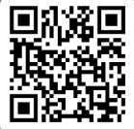
UNIVERSITY OF WASHINGTON
GRADUATE & PROFESSIONAL
STUDENT SENATE
SafeCampus (206-685-7233)
Call SafeCampus anytime to anonymously discuss safety and well-being concerns for yourself or others.
https://www.washington.edu/safecampus/
Childcare Assistance Program
https://www.washington.edu/financialaid/types-of-aid/child-care-assistance/
UW Food Pantry
https://www.washington.edu/anyhungryhusky/the-uw-food-pantry/
Student Technology Loan Program
The Student Technology Loan Program (STLP) is a free, student-led program that supports the academic technology needs of UW Seattle students
https://stlp.uw.edu/
Attendance Form
(Word of the Day: Impact)
Attendance Form Link:
https://forms.office.com/r/esdsmJd5us

Slide 2
Call To Order
1 min
Notes:
remind the Senate that all votes will be public. Zoom attendees should privately message VP of Admin with questions. Mention that there will be CART captioning for the meeting

Slide 3
1. Call to Order (Sponsor: Richard Schure, Time: 1 min.) [ACTION]
2. Approval of Agenda (Sponsor: Richard Schure, Time: 3 min.) [ACTION]
3. Approval of Minutes (Sponsor: Richard Schure, Time: 1 min.) [ACTION]
4. Land Acknowledgement (Sponsor: [Edith Dale] Time: 2 min.) [INFORMATION]
5. Announcements (Sponsor: Richard Schure, Time: 10 min.) [INFORMATION]
6. Joy Williamson-Lott, the Dean UW Graduate School (Sponsor: Richard Schure, Time: 15 minutes) [INFORMATION]
7. UW Impact (Sponsor: Noah Hough, Time: 15 minutes) [INFORMATION]
8. Alumni-Student Programming (ASP) at the UW Alumni Association (Sponsor: Noah Hough, Time: 10 minutes) [INFORMATION]
9. Resolution on Supporting the Installation of Sanitary Bins and Menstrual Product Dispensers in Male Restrooms for Greater Accessibility and Inclusion (First Reading) (Sponsor: Edith Dale, Héctor Delgado Díaz, Time: 5 minutes) [INFORMATION]
10. Resolution in Support of the Washington Yacht Club (First Reading) (Sponsor: Hannah Shipman, Time: 5 minutes) [INFORMATION]
11. Resolution to Acknowledge and Support Undocumented Students and Families (Second/ Third Reading) (Sponsor: Anthony Garcia, William Albers, Time: 30 min) [ACTION]
12. Senator of the Month (Sponsor: Edith Dale, Time: 10 min) [INFORMATION]
13. Adjournment (Sponsor: Richard Schure, Time: 1 min.) [ACTION]
Approval of Agenda
1 min
Total Time: 108 minutes
Anticipated End Time: 6:45 PM
Attendance Form Link:

Slide 4
Minutes from the 11/13/2024 and 12/04/2024 GPSS Meeting, as circulated by email by Senate Director Annika Peterson on 12/03/2024 and 1/21/2025 respectively.
Approval of Minutes
3 min
Attendance Form Link:
https://forms.office.com/r/esdsmJd5us

Slide 5
Land Acknowledgement
2 min
Notes:
Edith - Every community owes its existence and vitality to generations from around the world who contributed to making the history that led to this moment. Indigenous People have lived here continuously since time immemorial, and Seattle is now a highly cosmopolitan territory with overlapping sovereignties and fidelities. Acknowledging the land we are on is only the first step. Therefore the Graduate and Professional Student Senate at the University of Washington in Seattle acknowledges the Coast Salish peoples of this land, the land which touches the shared waters of all tribes and bands within the Suquamish, Tulalip, and Muckleshoot nations and all traditional lands on which we learn and work.

Slide 6
Within UW: - Get involved with LAB and the WSA! GPSS has advocated for a tuition waiver program for Native American students!
- wǝɫǝbʔaltxʷ - UW Intellectual House - https://www.washington.edu/diversity/intellectual-house/ - ASUW American Indian Student Commission (AISC): http://aisc.asuw.org Community: - Native and Strong Lifeline – 988 (option 4) The Native and Strong Lifeline is the first program of its kind in the nation dedicated to serving American Indian and Alaska Native people. Operated by Volunteers of America Western Washington, this line is available for people who call the 988 Lifeline and choose option 4. It is specifically for Washington’s American Indian and Alaska Native communities. Calls are answered by Native crisis counselors who are tribal members and descendants closely tied to their communities. Native and Strong Lifeline counselors are fully trained in crisis intervention and support, with special emphasis on cultural and traditional practices related to healing. - Stand with the Duwamish: https://www.duwamishtribe.org/stand-with-the-duwamish - Real Rent Duwamish: https://www.realrentduwamish.org
Resources for Action
Notes:
Edith - Washington Student Association
In addition to the land acknowledgement, we would also like to acknowledge a couple more things.
In light of recent events, particularly the executive orders signed on Monday, we want you to know that GPSS stands in solidarity with all communities who are directly impacted, especially Black, Indigenous, people of color, immigrants, women, transgender, queer, and those who are at risk of having their rights threatened. The harmful actions we’ve witnessed contradict the values of diversity, equity, and inclusion that we hold dear at GPSS.
GPSS is committed to being a resource for support, advocacy, and change. We stand together to ensure that marginalized voices are heard and that we continue to fight for a more just and equitable society. We will not waver in our advocacy for DEI, and we remain resolute in our mission to create a welcoming and inclusive space for all.
If anyone needs support or resources, please don’t hesitate to reach out. We are here to listen, support, and amplify your voices. Together, we will continue to advocate for the change we wish to see in our communities and in the world.

Slide 7
Announcements
10 min

Slide 10
GPSS Diversity Funds
https://depts.washington.edu/gpss/funding/diversity-funds/
Notes:
mykhail

Slide 12
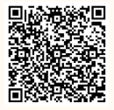
RSVP by 12pm on Monday (1/27)
https://forms.office.com/r/Ke8rNSJaU1

Slide 14
Graduate Student Bowling Night
Friday, Jan. 24, 2025, 4 p.m. - 6 p.m HUB Games, UW Seattle
bit.ly/wgsbn

Slide 15
Lunar New Year Celebration
Friday, January 31, 2025
5:00 pm - 7:30 pm
Intellectual House

Slide 16
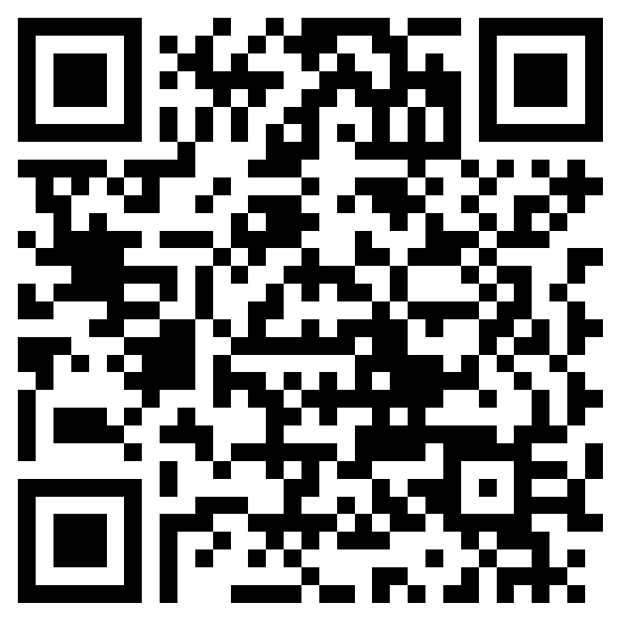
2025 Huskies on the Hill RSVP
https://forms.office.com/r/8Gd8aWNJtm
February 3rd, 2025
Lunch and transit provided!
Seattle Departure at 8:15am
Seattle arrival at 5:30pm
More details in RSVP form!
Notes:
mykhail

Slide 17
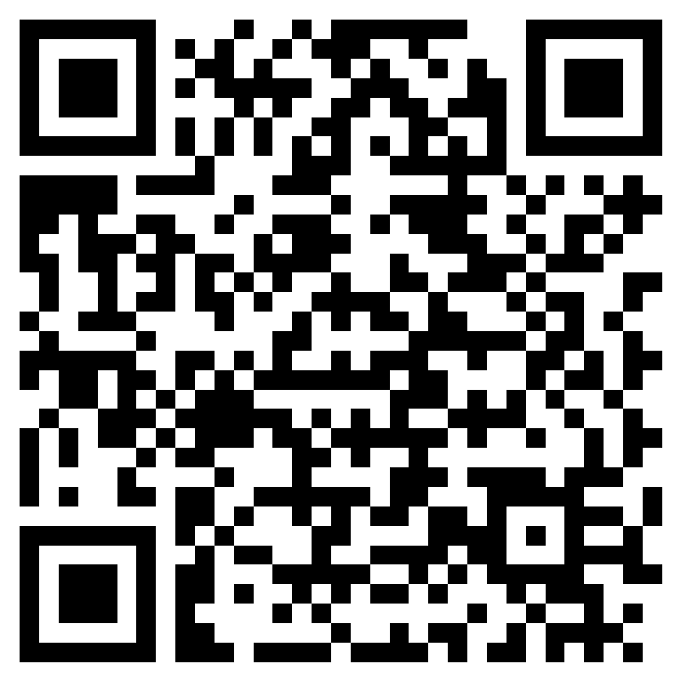
Share Your Story & Graduate Action Committee Survey
https://forms.office.com/r/R9u9Hb4cz6
Job Shadow and Informational Interview Opportunities!
Notes:
mykhail

Slide 18
GPSS Website Survey
Help us create a better web experience for GPSS
More information: Contact Vidya at gpsswebhelp@uw.edu
https://forms.office.com/r/QiHF7GcTqf

Slide 19
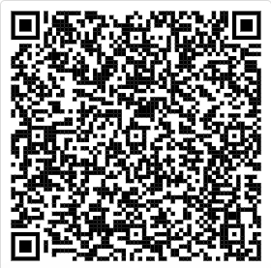
Senator Resources
That will help you to succeed as a Senator!
https://tinyurl.com/senator-resources

Slide 20
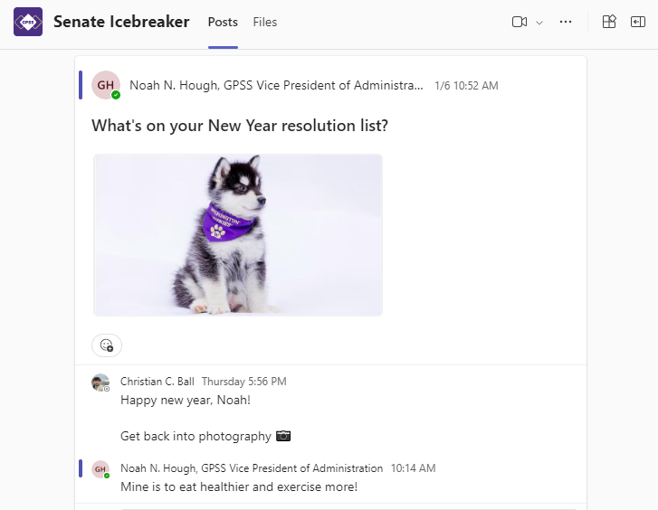
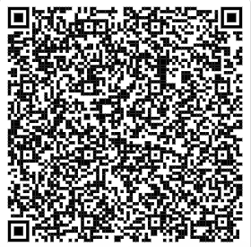
Follow us on Instagram!
Introduce yourself on Teams channel

Slide 21
Joy Williamson-Lott, the Dean UW Graduate School
15 min

Slide 22
UW Impact
15 min

Slide 25
Alumni-Student Programming (ASP) at the UW Alumni Association
10 min

Slide 30
Resolution on Supporting the Installation of Sanitary Bins and Menstrual Product Dispensers in Male Restrooms for Greater Accessibility and Inclusion
5 min

Slide 31
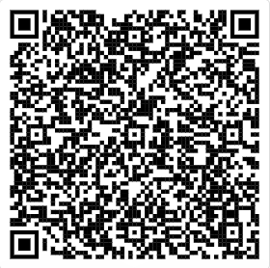
Resolution on Supporting the Installation of Sanitary Bins and Menstrual Product Dispensers in Male Restrooms for Greater Accessibility and Inclusion
You may review the Resolution using this link (Log in with UW account)
Resolution- Concerning lack of sanitary bins in male toilets.docx

Slide 32
Resolution in Support of the Washington Yacht Club
5 min

Slide 33
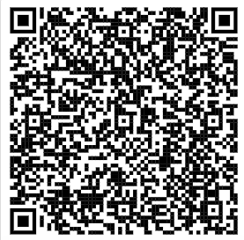
Resolution in Support of the Washington Yacht Club
You may review the Resolution using this link (Log in with UW account)
Resolution in support of the Washington Yacht Club.docx

Slide 34
Resolution to Acknowledge and Support Undocumented Students and Families
30 min

Slide 35
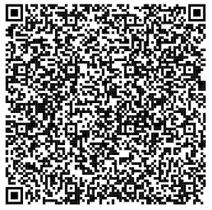
Resolution to Acknowledge and Support Undocumented Students and Families
You may review the Resolution using this link (Log in with UW account)
RESOLUTION TO ACKNOWLEDGE AND SUPPORT UNDOCUMENTED STUDENTS AND FAMILIES.docx

Slide 36
Resolution to Acknowledge and Support Undocumented Students and Families
Please vote using this form (log in with UW account)
https://forms.office.com/r/Y2meDFWt71

Slide 37
Senator of the Month
10 min

Slide 38
Congratulations, Charles!
Thank you for your engagement!

Slide 39
Congratulations, Alec!
Thank you for your engagement!

Slide 40
Adjournment
1 min

