Slide 1
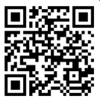
UNIVERSITY OF WASHINGTON
GRADUATE & PROFESSIONAL
STUDENT SENATE
SafeCampus (206-685-7233)
Call SafeCampus anytime to anonymously discuss safety and well-being concerns for yourself or others.
https://www.washington.edu/safecampus/
Childcare Assistance Program
https://www.washington.edu/financialaid/types-of-aid/child-care-assistance/
UW Food Pantry
https://www.washington.edu/anyhungryhusky/the-uw-food-pantry/
Student Technology Loan Program
The Student Technology Loan Program (STLP) is a free, student-led program that supports the academic technology needs of UW Seattle students
https://stlp.uw.edu/
Attendance Form
(Word of the Day: Holiday)
Attendance Form Link:
https://forms.office.com/r/UfK9fPb8JS

Slide 2
Call To Order
1 min
Notes:
remind the Senate that all votes will be public. Zoom attendees should privately message VP of Admin with questions. Mention that there will be CART captioning for the meeting

Slide 3
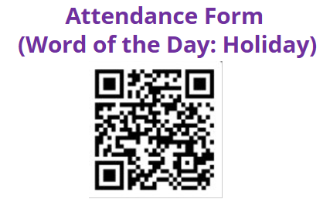
1. Call to Order (Sponsor: Richard Schure, Time: 1 min.) [ACTION]
2. Approval of Agenda (Sponsor: Richard Schure, Time: 1 min.) [ACTION]
3. Approval of Minutes (Sponsor: Richard Schure, Time: 1 min.) [ACTION]
4. Land Acknowledgement (Sponsor: [Edith Dale] Time: 2 min.) [INFORMATION]
5. Announcements (Sponsor: Richard Schure, Time: 10 min.) [INFORMATION]
6. Resolution to Acknowledge and Support Undocumented Students and Families (First Reading) (Sponsor: Anthony Garcia, William Albers, Time: 5 min) [ACTION]
7. Resolution to Use Preferred Name of Students in Communications (First Reading, Second Reading, and Third Reading /Vote) (Sponsor: Alec Solemslie, Ella Spurlock, Time: 30 min) [ACTION]
8. Judicial Committee Member Approval (Sponsor: Noah Hough, Time: 10 min.) [ACTION]
9. Senator of the Month (Sponsor: Edith Dale, Time: 5 min.) [INFORMATION]
10. Adjournment (Sponsor: Richard Schure, Time: 1 min.) [ACTION]
Approval of Agenda
1 min
Total Time: 66 minutes
Anticipated End Time: 6:45 PM
Attendance Form Link:
https://forms.office.com/r/UfK9fPb8JS

Slide 4
Minutes from the 11/13/2024 GPSS Meeting, as circulated by email by Senate Director Annika Peterson on 12/03/2024
Approval of Minutes
1 min
Attendance Form Link:
https://forms.office.com/r/UfK9fPb8JS

Slide 5
Land Acknowledgement
2 min
Notes:
Edith - Every community owes its existence and vitality to generations from around the world who contributed to making the history that led to this moment. Indigenous People have lived here continuously since time immemorial, and Seattle is now a highly cosmopolitan territory with overlapping sovereignties and fidelities. Acknowledging the land we are on is only the first step. Therefore the Graduate and Professional Student Senate at the University of Washington in Seattle acknowledges the Coast Salish peoples of this land, the land which touches the shared waters of all tribes and bands within the Suquamish, Tulalip, and Muckleshoot nations and all traditional lands on which we learn and work.

Slide 6
Within UW: - Get involved with LAB and the WSA! GPSS has advocated for a tuition waiver program for Native American students!
- wǝɫǝbʔaltxʷ - UW Intellectual House - https://www.washington.edu/diversity/intellectual-house/ - ASUW American Indian Student Commission (AISC): http://aisc.asuw.org Community: - Native and Strong Lifeline – 988 (option 4) The Native and Strong Lifeline is the first program of its kind in the nation dedicated to serving American Indian and Alaska Native people. Operated by Volunteers of America Western Washington, this line is available for people who call the 988 Lifeline and choose option 4. It is specifically for Washington’s American Indian and Alaska Native communities. Calls are answered by Native crisis counselors who are tribal members and descendants closely tied to their communities. Native and Strong Lifeline counselors are fully trained in crisis intervention and support, with special emphasis on cultural and traditional practices related to healing. - Stand with the Duwamish: https://www.duwamishtribe.org/stand-with-the-duwamish - Real Rent Duwamish: https://www.realrentduwamish.org
Resources for Action
Notes:
Edith - Washington Student Association

Slide 7
Announcements
10 min

Slide 8
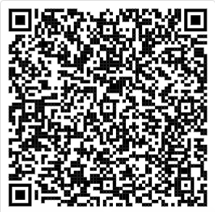
Senator Resources
That will help you to succeed as a Senator!
https://tinyurl.com/senator-resources

Slide 9
GPSS Website Survey
Help us create a better web experience for GPSS
More information: Contact Vidya at gpsswebhelp@uw.edu
https://forms.office.com/r/QiHF7GcTqf

Slide 10
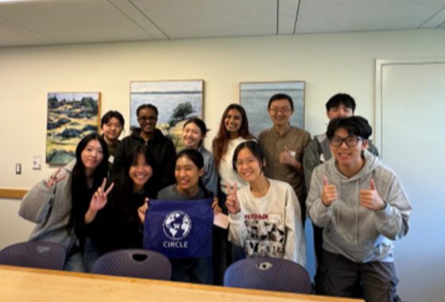
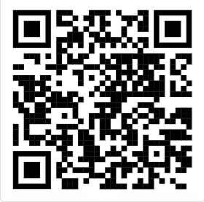
CIRCLE Student Advisory Board (SAB)
The CIRCLE Student Advisory Board (SAB) is an international student-led committee that strives to advocate for and enrich the UW international experience. If you are interested in learning more about or joining the board, check out the link below.
https://tinyurl.com/CIRCLE-SAB

Slide 11
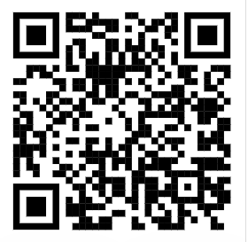
Unite UW program
The United UW program is a cross-cultural exchange program that creates space for domestic and international students to connect. Through Unite UW, many have found a home-like community. If you are interested in joining, check out the winter application link below!
https://tinyurl.com/unite-uw

Slide 12
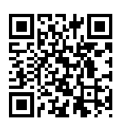
Apply to be a Tillman Scholar
The Pat Tillman Foundation identifies remarkable military service members, veterans and spouses, empowering them with academic scholarships, lifelong leadership development opportunities and a diverse, global community of high-performing mentors and peers. Scholars make an impact in the fields of healthcare, business, public service, STEM, education and the humanities. Average amount per year: $10,000.
https://tinyurl.com/tillman-scholar

Slide 13
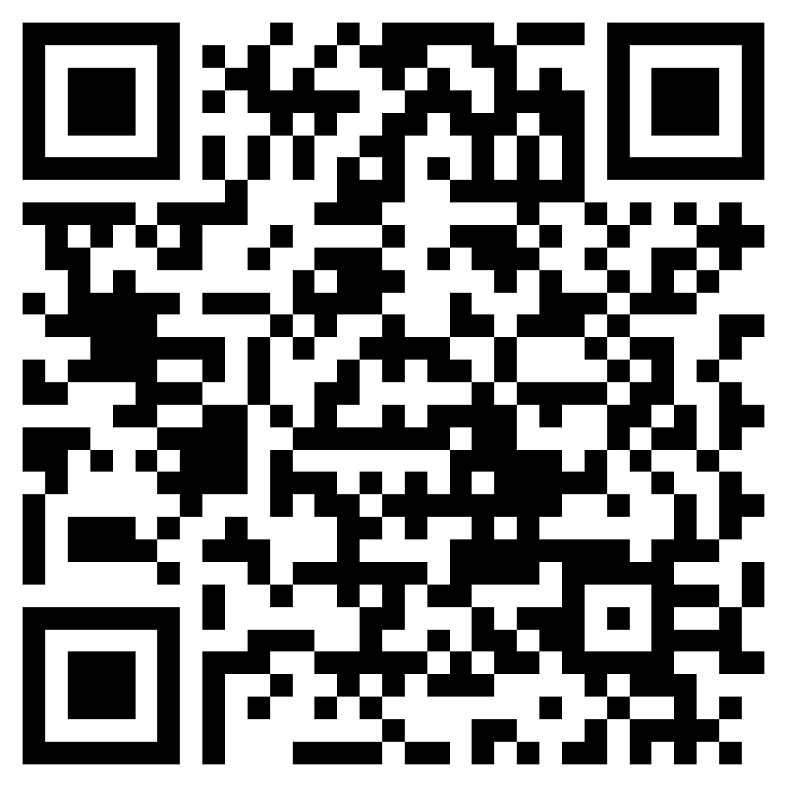
2025 Huskies on the Hill RSVP
https://forms.office.com/r/8Gd8aWNJtm
February 3rd, 2025
Lunch and transit provided!
Seattle Departure at 8:15am
Seattle arrival at 5:30pm
More details in RSVP form!
Notes:
mykhail

Slide 14
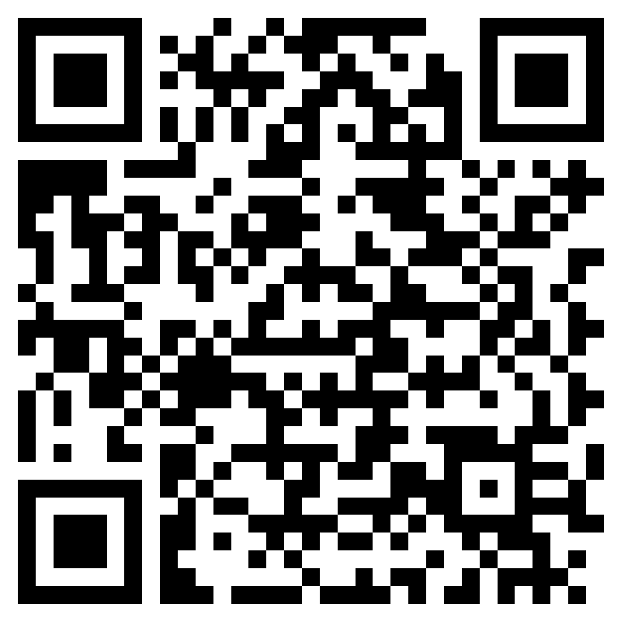
Share Your Story & Graduate Action Committee Survey
https://forms.office.com/r/R9u9Hb4cz6
Job Shadow and Informational Interview Opportunities!
Notes:
mykhail

Slide 15
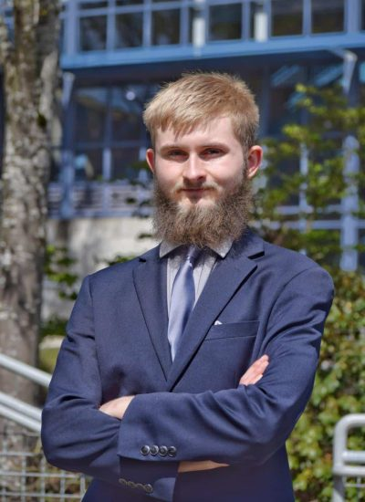
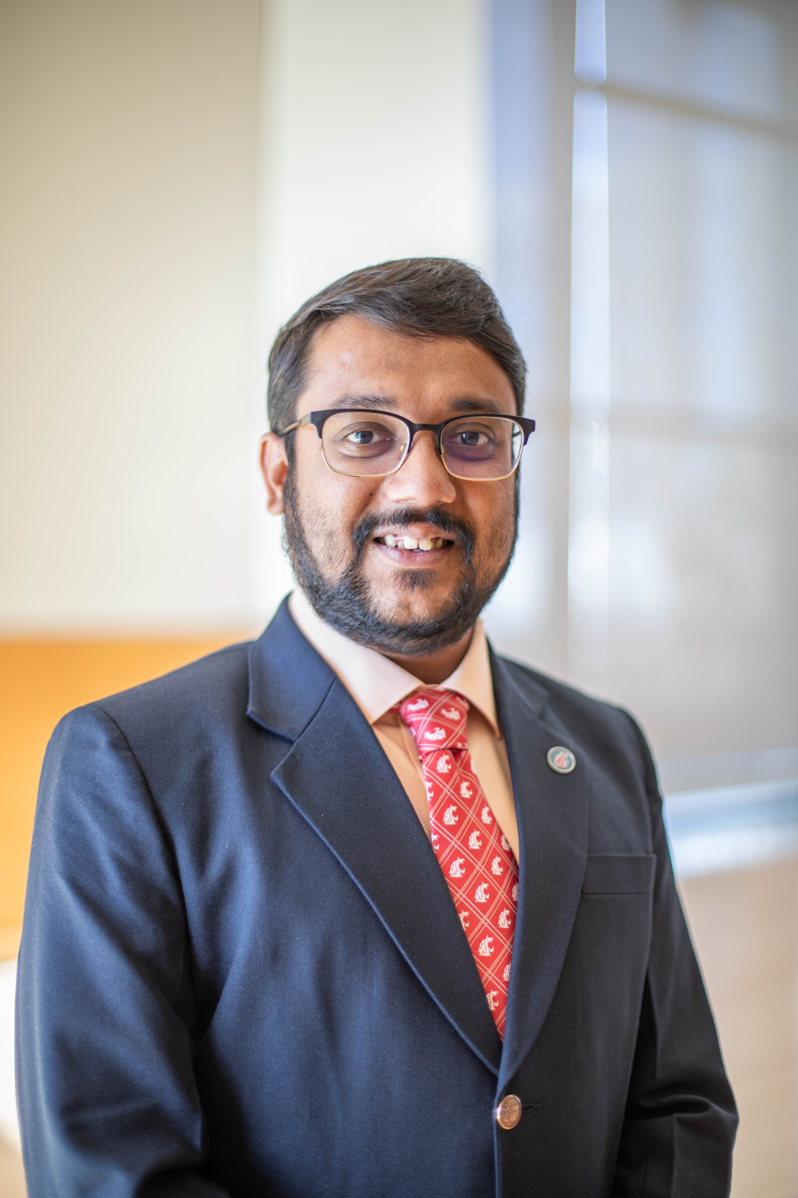
WA Student Association elects new Vice President of Graduate and Professional Student Affairs
GPSS Vice President of Finance Ryan Wicklund was elected on Dec 2nd to serve in the WSA's executive board and chair their committee on graduate and professional student affairs starting in January 2025, continuing the work of the current WSA Vice President Tathagata Pal.
Email Pal/Ryan at gradprofs@wastudents.org for legislative concerns relating to WSA or graduate and professional student affairs at the state or federal level.
Notes:
mykhail

Slide 16
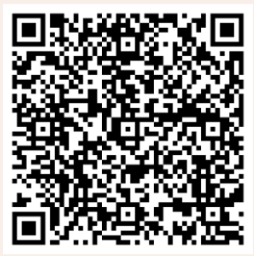
GPSS Winter Formal
Saturday,
December 7th
^{7:00 PM - 10:00 PM}
^{Vista Café}
Music, Food, Drinks & Photobooth! Come out for an evening of dressing up and celebrate the end of the quarter.
RSVP: https://forms.office.com/Pages/ResponsePage.aspx?id=W9229i_wGkSZoBYqxQYL0gmYRYzJbSNFkus_YyDoQa5URVpYUjlMMjM4SExUNFdYNzlNWTdPNU5XQy4u
Notes:
kana

Slide 17
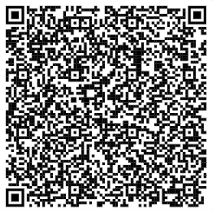
Follow us on Instagram!
Introduce yourself on Teams channel

Slide 18
Resolution to Acknowledge and Support Undocumented Students and Families
5 min

Slide 19
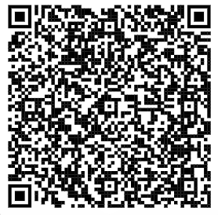
Resolution to Acknowledge and Support Undocumented Students and Families
You may review the Resolution using this link (Log in with UW account)
RESOLUTION TO ACKNOWLEDGE AND SUPPORT UNDOCUMENTED STUDENTS AND FAMILIES.docx

Slide 20
Resolution to Use Preferred Name of Students in Communications
30 min

Slide 21
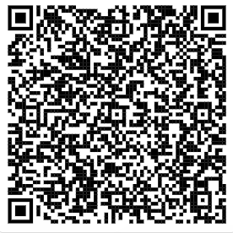
Resolution to Use Preferred Name of Students in Communications
You may review the Resolution using this link (Log in with UW account)
RESOLUTION TO USE PREFERRED NAMES OF STUDENTS IN COMMUNICATIONS.docx

Slide 22
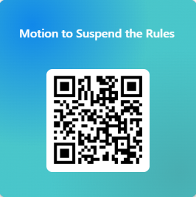
Motion to Suspend the Rules
Because this resolution is time-sensitive, this motion will allow to move to a second/third reading so that the Senate can vote on the Resolution at this meeting.
https://forms.office.com/r/BDFtVDPAjd

Slide 23
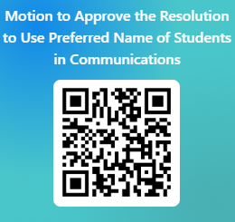
Resolution to Use Preferred Name of Students in Communications
Please vote using this form (log in with UW account)
https://forms.office.com/r/cDwnK3cGBc

Slide 24
Judicial Committee Member Approval
10 min

Slide 25
Senator of the Month
5 min

Slide 26
Congratulations, Charles!
Thank you for your engagement!

Slide 27
Adjournment
1 min

