Slide 1
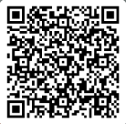
UNIVERSITY OF WASHINGTON
GRADUATE & PROFESSIONAL
STUDENT SENATE
SafeCampus (206-685-7233)
Call SafeCampus anytime to anonymously discuss safety and well-being concerns for yourself or others.
https://www.washington.edu/safecampus/
Childcare Assistance Program
https://www.washington.edu/financialaid/types-of-aid/child-care-assistance/
UW Food Pantry
https://www.washington.edu/anyhungryhusky/the-uw-food-pantry/
Student Technology Loan Program
The Student Technology Loan Program (STLP) is a free, student-led program that supports the academic technology needs of UW Seattle students
https://stlp.uw.edu/
Attendance Form
(Word of the Day: Pulchritudinous)
Attendance Form Link:
https://forms.office.com/r/d0cSuYLhtV

Slide 2
Call To Order
1 min
Notes:
remind the Senate that all votes will be public. Zoom attendees should privately message VP of Admin with questions. Mention that there will be CART captioning for the meeting

Slide 3
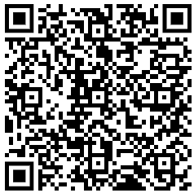
1. Call to Order (Sponsor: Richard Schure, Time: 1 min.) [ACTION]
2. Approval of Agenda (Sponsor: Richard Schure, Time: 1 min.) [ACTION]
3. Approval of Minutes (Sponsor: Richard Schure, Time: 3 min.) [ACTION]
4. Land Acknowledgement (Sponsor: Edith Dale Time: 2 min.) [INFORMATION]
5. Announcements/ Public Comments (Sponsor: Richard Schure, Time: 10 min.) [INFORMATION] 6. HB-1485 (Sponsor: Joe Rogge, Time: 5 min) [INFORMATION]
7. Resolution on Supporting the Installation of Sanitary Bins and Menstrual Product Dispensers in Male Restrooms for Greater Accessibility and Inclusion (Second/ Third Reading) (Sponsor: Edith Dale, Héctor Delgado Díaz, Time: 25 minutes) [ACTION]
8. Resolution For the Expansion of Class Accessibility (First Reading) (Sponsor: Autumn Yi, Time: 5 min) [INFORMATION]
9. Resolution in Support of the Washington Yacht Club (Second/ Third Reading) (Sponsor: Hannah Shipman, Time: 25 minutes) [ACTION]
9. Resolution on the Fatal Stabbing of King County Metro Bus Driver Shawn Yim (First Reading) (Sponsor: Emilio Castañeda, Time: 5 min) [INFORMATION]
10. GPSS Election Guide (Sponsor: Hannah Shipman, Alec Solemslie, Time: 20 min.) [ACTION]
11. Senator of the Month (Sponsor: Edith Dale, Time: 5 min) [INFORMATION]
12. Officer Updates (Sponsor: Richard Schure, Time: 30 min) [INFORMATION]
13. U-PASS (Sponsor: Richard Schure, Time: 5 min.) [INFORMATION]
14. Adjournment (Sponsor: Richard Schure, Time: 1 min.) [ACTION]
Approval of Agenda
1 min
Total Time: 133 minutes
Anticipated End Time: 7:45 PM
Word of the Day: Pulchritudinous​
Attendance Form Link: https://forms.office.com/r/d0cSuYLhtV

Slide 4
Minutes from the GPSS Meeting 01/22, as circulated by email by Senate Director Annika Peterson on 2/18.
Approval of Minutes
3 min
Word of the Day: Pulchritudinous
Attendance Form Link:
https://forms.office.com/r/d0cSuYLhtV

Slide 5
Land Acknowledgement
2 min
Notes:
Edith - Every community owes its existence and vitality to generations from around the world who contributed to making the history that led to this moment. Indigenous People have lived here continuously since time immemorial, and Seattle is now a highly cosmopolitan territory with overlapping sovereignties and fidelities. Acknowledging the land we are on is only the first step. Therefore the Graduate and Professional Student Senate at the University of Washington in Seattle acknowledges the Coast Salish peoples of this land, the land which touches the shared waters of all tribes and bands within the Suquamish, Tulalip, and Muckleshoot nations and all traditional lands on which we learn and work.

Slide 6
Within UW: - Get involved with LAB and the WSA! GPSS has advocated for a tuition waiver program for Native American students!
- wǝɫǝbʔaltxʷ - UW Intellectual House - https://www.washington.edu/diversity/intellectual-house/ - ASUW American Indian Student Commission (AISC): http://aisc.asuw.org Community: - Native and Strong Lifeline – 988 (option 4) The Native and Strong Lifeline is the first program of its kind in the nation dedicated to serving American Indian and Alaska Native people. Operated by Volunteers of America Western Washington, this line is available for people who call the 988 Lifeline and choose option 4. It is specifically for Washington’s American Indian and Alaska Native communities. Calls are answered by Native crisis counselors who are tribal members and descendants closely tied to their communities. Native and Strong Lifeline counselors are fully trained in crisis intervention and support, with special emphasis on cultural and traditional practices related to healing. - Stand with the Duwamish: https://www.duwamishtribe.org/stand-with-the-duwamish - Real Rent Duwamish: https://www.realrentduwamish.org
Resources for Action
Notes:
Edith - Washington Student Association
In addition to the land acknowledgement, we would also like to acknowledge a couple more things.
In light of recent events, particularly the executive orders signed on Monday, we want you to know that GPSS stands in solidarity with all communities who are directly impacted, especially Black, Indigenous, people of color, immigrants, women, transgender, queer, and those who are at risk of having their rights threatened. The harmful actions we’ve witnessed contradict the values of diversity, equity, and inclusion that we hold dear at GPSS.
GPSS is committed to being a resource for support, advocacy, and change. We stand together to ensure that marginalized voices are heard and that we continue to fight for a more just and equitable society. We will not waver in our advocacy for DEI, and we remain resolute in our mission to create a welcoming and inclusive space for all.
If anyone needs support or resources, please don’t hesitate to reach out. We are here to listen, support, and amplify your voices. Together, we will continue to advocate for the change we wish to see in our communities and in the world.

Slide 7
Announcements/ Public Comments
10 min

Slide 8
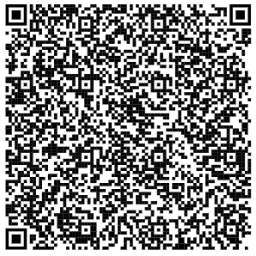
Application Open: Graduate Student Labor Research Grant 25/26AY
Grants of up to $5,000 are available to graduate students, from all UW campuses, whose proposed research is significant to the interdisciplinary field of labor studies. Applicants must plan on being active in the 2025-2026 academic year.
The deadline for all application materials is February 27th, 2025. Please send all materials, including the letter of support, to Rachel Erstad at rerstad@uw.edu by 11:59 p.m. on February 27th.
https://shorturl.at/10KCa

Slide 9
Cultural Cooking & Family Gathering for International Graduate Students
Saturday, February 22, 11:00 am - 1:00 pm Schmitz Hall, Room 250 Google Map: https://maps.app.goo.gl/qeiQfHi1osNQNCgo7 Campus Map: https://www.washington.edu/maps/#!/smz
Space is limited.
RSVP is required: https://forms.office.com/r/RfCS9dUbxd If you are a UW international graduate student parent with kids and/or spouse from your home country, CIRCLE invites you and your families to join us for a day of delicious food, a heartwarming movie, and hands-on crafts! We welcome you to bring a dish from your culture (if you’re able!) and share its story—what makes it special! This is a wonderful opportunity to celebrate flavors from around the world, so come hungry—not just for food, but for new experiences and connections! Also, get creative with your little ones to craft your favorite meal with colored paper and art supplies! Make a paper pizza, color in a sushi roll, or paint a homecooked meal. A perfect opportunity to unwind, recharge, and connect with other families while celebrating culture, community, and creativity. We can’t wait to see you there! This event is sponsored for the Center for International Relations and Cultural Leadership Exchange (CIRCLE). Send questions to Ziyan Bai at baiziyan@uw.edu.
Notes:
Linda Zhang

Slide 10
Career Connect: A Professional Networking Event for International Graduate Students
Monday, February 24, 3:00 - 4:30 pm Husky Union Building (HUB), Room 334 Google Map: https://maps.app.goo.gl/1jCzf58yA1wvWWzQ6 Campus Map: https://www.washington.edu/maps/#!/hub
RSVP is required: https://forms.office.com/r/1sf0xkKyjC If you’re an international graduate student interested in learning about the transition from academia to the workforce, come join us for Career Connect: A Professional Networking Event for International Graduate Students. You are invited to join us for a panel of professionals with graduate degrees who will share their experiences navigating the shift from school to their careers. There will be opportunities to ask questions, connect with fellow graduate students, and practice your networking skills in a supportive environment! This event is sponsored for the Center for International Relations and Cultural Leadership Exchange (CIRCLE). Send questions to Ziyan Bai at baiziyan@uw.edu.
Notes:
Linda Zhang

Slide 11
Family Fun Time for UW International Graduate Students: Pottery Painting
Family Fun Time for UW International Graduate Students: Pottery Painting Sunday, March 2, 6:30 - 7:30 pm Paint the Town (University Village) Google Map: https://goo.gl/maps/wPukqPb3DUEKL64Z8
Space is limited.
RSVP is required: https://forms.office.com/r/pAWBVV8HV7 If you are an UW international graduate student parent with kids and/or spouse from your home country, CIRCLE invites you and your families to join us for an after-school social at Paint the Town with pottery to paint and color. You and your families will have an opportunity to connect with other UW students with families and enjoy a relaxed time away from graduate school to recharge and refuel. Most important, you will take home your painted pottery a week from the event. This event is sponsored by the Center for International Relations and Cultural Leadership Exchange (CIRCLE). Send questions to Ziyan Bai at baiziyan@uw.edu.
Notes:
Linda Zhang

Slide 12
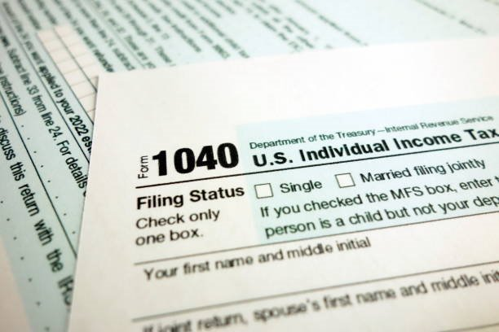
File your taxes before April 15!
https://iss.washington.edu/campus-spotlight-uw-vita/
Where to go: UW Dempsey Hall in Room 212
When to visit: Tuesdays, Thursdays, and Fridays 11:00 am – 2:30 pm
What to bring:
A government issued photo-ID
Social Security Card or International Taxpayer Number
All your tax forms!
UW VITA will be closed during Finals Week and Spring Break.
UW Volunteer Income Tax Assistance​
Notes:
Linda Zhang

Slide 18
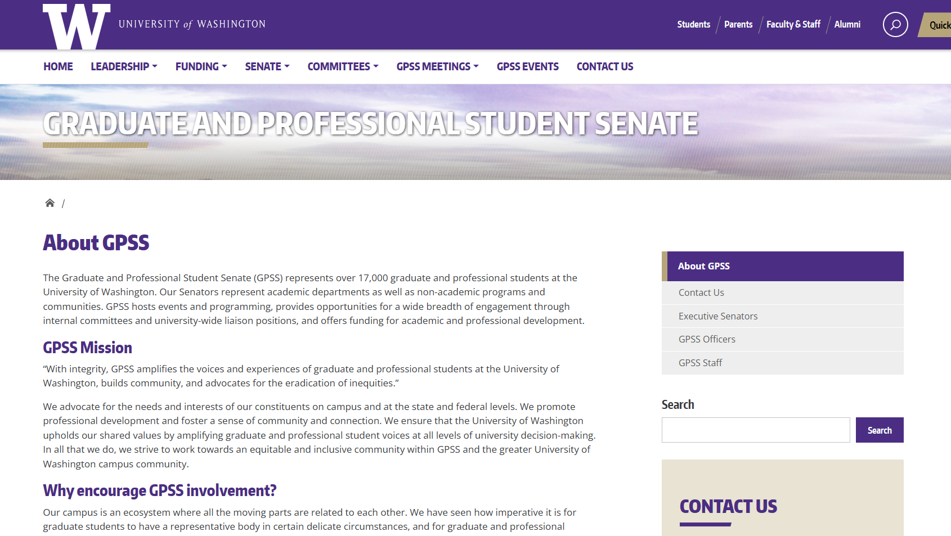
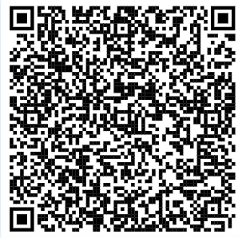
GPSS New Website
Feedback Form:
Website Feedback Form

Slide 19
Notes:
mykhail

Slide 24
HB-1485
5 min

Slide 25
Resolution on Supporting the Installation of Sanitary Bins and Menstrual Product Dispensers in Male Restrooms for Greater Accessibility and Inclusion
25 min

Slide 26
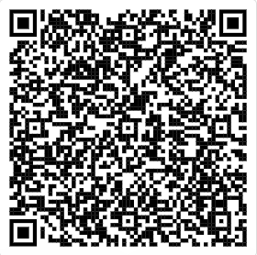
Resolution on Supporting the Installation of Sanitary Bins and Menstrual Product Dispensers in Male Restrooms for Greater Accessibility and Inclusion
You may review the Resolution using this link (Log in with UW account)
Resolution- Concerning lack of sanitary bins in male toilets.docx

Slide 27
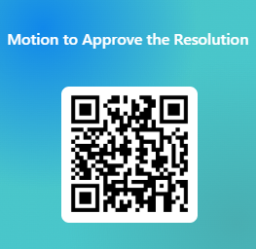
Resolution on Supporting the Installation of Sanitary Bins and Menstrual Product Dispensers in Male Restrooms for Greater Accessibility and Inclusion
Please vote using this form (log in with UW account)
https://forms.office.com/r/QbBmVwrkrY

Slide 28
Resolution For the Expansion of Class Accessibility
5 min

Slide 29
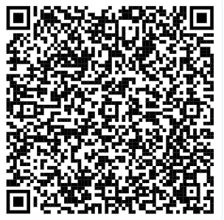
Resolution For the Expansion of Class Accessibility
You may review the Resolution using this link (Log in with UW account)
Resolution for the Expansion of Class Accessibility.docx

Slide 30
Resolution in Support of the Washington Yacht Club
25 min

Slide 31
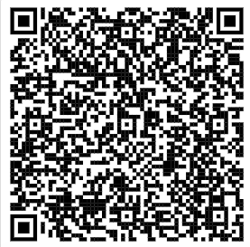
Resolution in Support of the Washington Yacht Club
You may review the Resolution using this link (Log in with UW account)
Resolution in support of the Washington Yacht Club.docx

Slide 32
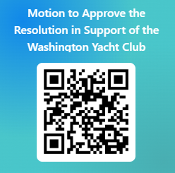
Resolution in Support of the Washington Yacht Club
Please vote using this form (log in with UW account)
https://forms.office.com/r/4Ba5D4Ywdp

Slide 33
GPSS Election Guide
20 min

Slide 34
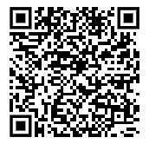
GPSS 2025-2026 Election Guide
You may review the Resolution using this link (Log in with UW account)
ElectionsGuide_Proposed2025_V2.docx

Slide 35
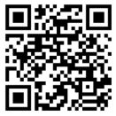
Motion to Approve the 2025-2026 Election Guide
Please vote using this form (log in with UW account)
https://forms.office.com/r/iPitN4J3Ki

Slide 36
Senator of The Month
5 min

Slide 37
Congratulations, Alexandros!
Thank you for your engagement!

Slide 38
Officer Updates
30 min

Slide 39
U-PASS
5 min

Slide 40
Adjournment
1 min

