Slide 1
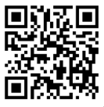

UNIVERSITY OF WASHINGTON
GRADUATE & PROFESSIONAL
STUDENT SENATE
SafeCampus (206-685-7233)
Call SafeCampus anytime to anonymously discuss safety and well-being concerns for yourself or others.
https://www.washington.edu/safecampus/
Childcare Assistance Program
https://www.washington.edu/financialaid/types-of-aid/child-care-assistance/
UW Food Pantry
https://www.washington.edu/anyhungryhusky/the-uw-food-pantry/
Student Technology Loan Program
The Student Technology Loan Program (STLP) is a free, student-led program that supports the academic technology needs of UW Seattle students
https://stlp.uw.edu/
Attendance Form
(Word of the Day: Insouciance)
Attendance Form Link:
https://forms.office.com/r/xyNufLWxJF

Slide 2
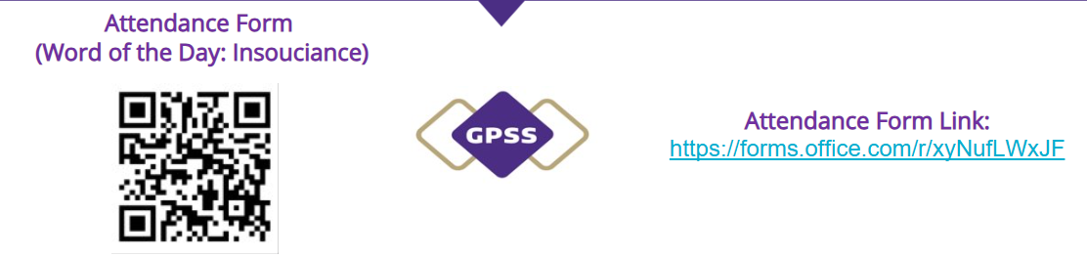
Call To Order
1 min
Notes:
remind the Senate that all votes will be public. Zoom attendees should privately message VP of Admin with questions. Mention that there will be CART captioning for the meeting

Slide 3
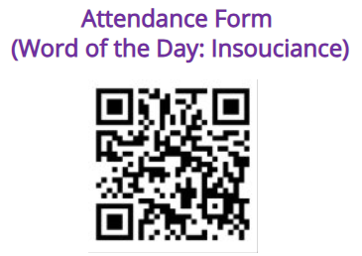

1. Call to Order (Sponsor: Richard Schure, Time: 1 min.) [ACTION]
2. Approval of Agenda (Sponsor: Richard Schure, Time: 1 min.) [ACTION]
3. Approval of Minutes (Sponsor: Richard Schure, Time: 1 min.) [ACTION]
4. Land Acknowledgement (Sponsor: Edith Dale Time: 2 min.) [INFORMATION]
5. Announcements/ Public Comments (Sponsor: Richard Schure, Time: 5 min.) [INFORMATION]
6. GPSS 2025-2026 Election Candidate Presentations (Sponsor: Alec Solemslie, Time: 90 min.) [INFORMATION]
7. GPSS Election Candidate Discussion (Sponsor: Alec Solemslie, Time: 30 min.) [INFORMATION]
8. GPSS 2025 – 2026 Election Voting (Sponsor: Alec Solemslie, Time: 15 min.) [ACTION]
9. GPSS 2025 – 2025 Election Results (Sponsor: Alec Solemslie, Time: 5 min.) [INFORMATION]
10. Resolution in Calling on University Administrators to Speak Out About Federal Funding Cuts and Overreach (Second/ Third Reading) (Sponsor: Ella Spurlock, Time: 20 min.) [ACTION]
11. Resolution to Support the Reinstatement of The Hooding Ceremony of the Graduate Programs at University of Washington, Bothell (First/ Second/ Third Reading) (Sponsor: Mykhail Lembke, Time: 15 min.) [ACTION]
12. Senator of the Month (Sponsor: Edith Dale, Time: 5 min.) [INFORMATION]
13. Adjournment (Sponsor: Richard Schure, Time: 1 min.) [ACTION]
Approval of Agenda
1 min
Total Time: 191 minutes​​
Anticipated End Time: 8:45 PM

Slide 4
Minutes from the GPSS Meeting 04/23, as circulated by email by Senate Director Annika Peterson on 5/6.
Approval of Minutes
1 min
Attendance Form Link: ​
https://forms.office.com/r/xyNufLWxJF

Slide 5
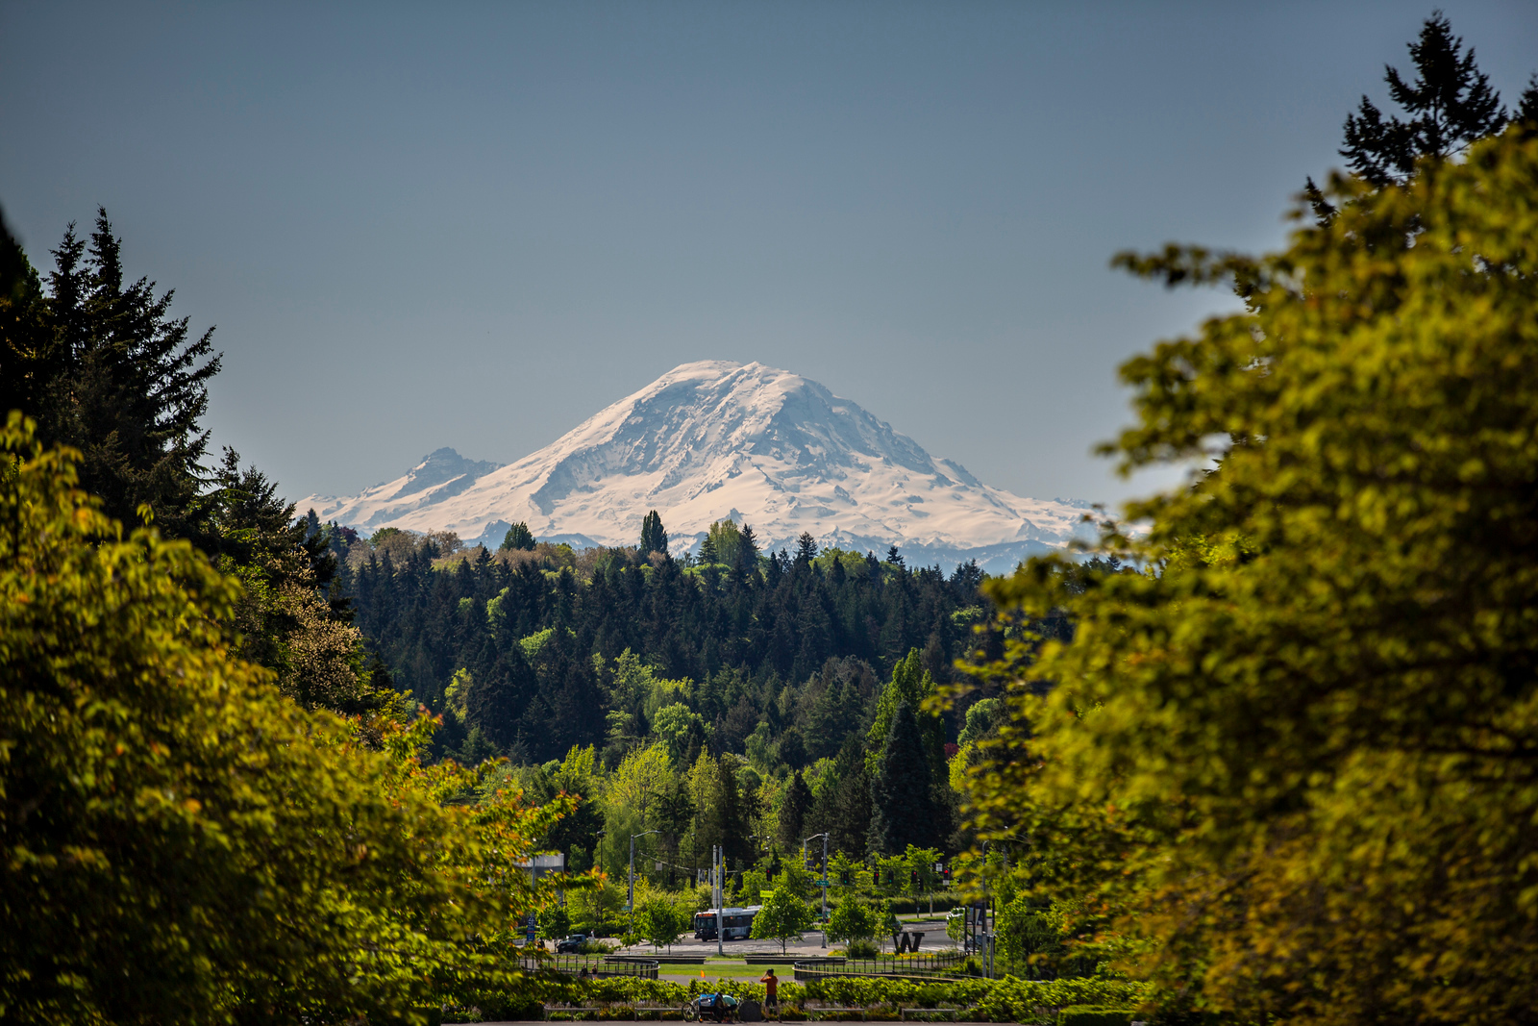
Land Acknowledgement
2 min
Notes:
Edith - Every community owes its existence and vitality to generations from around the world who contributed to making the history that led to this moment. Indigenous People have lived here continuously since time immemorial, and Seattle is now a highly cosmopolitan territory with overlapping sovereignties and fidelities. Acknowledging the land we are on is only the first step. Therefore the Graduate and Professional Student Senate at the University of Washington in Seattle acknowledges the Coast Salish peoples of this land, the land which touches the shared waters of all tribes and bands within the Suquamish, Tulalip, and Muckleshoot nations and all traditional lands on which we learn and work.

Slide 6

Within UW:
- Get involved with LAB and the WSA! GPSS has advocated for a tuition waiver program for Native American students
- wǝɫǝbʔaltxʷ - UW Intellectual House - https://www.washington.edu/diversity/intellectual-house/
- ASUW American Indian Student Commission (AISC): http://aisc.asuw.org
Community:
- Native and Strong Lifeline – 988 (option 4)
The Native and Strong Lifeline is the first program of its kind in the nation dedicated to serving American Indian and Alaska Native people. Operated by Volunteers of America Western Washington, this line is available for people who call the 988 Lifeline and choose option 4. It is specifically for Washington’s American Indian and Alaska Native communities. Calls are answered by Native crisis counselors who are tribal members and descendants closely tied to their communities. Native and Strong Lifeline counselors are fully trained in crisis intervention and support, with special emphasis on cultural and traditional practices related to healing.
- Stand with the Duwamish: https://www.duwamishtribe.org/stand-with-the-duwamish
Resources for Action
- Real Rent Duwamish: https://www.realrentduwamish.org
Other resources:
Find out whose traditional land you live on with this interactive map: https://native-land.ca/
What is the purpose of a land acknowledgement? https://retirees.uw.edu/event/from-recognition-to-action-understanding-land-acknowledgments/
- Article from Patagonia: All Trails Belong to Mother Earth, Following in Indigenous Footsteps on the Ute Pass Trail
Documentary on "The Rights of Nature: A Global Movement"
Notes:
Edith - Washington Student Association

Slide 7
Announcements/ Public Comments
5 min

Slide 8


Slide 9
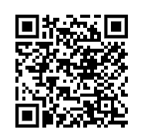
GPSS Legislative Agenda for AY 2026
https://forms.office.com/r/rGWJ2UsK4e?origin=lprLink
Each year, the Graduate and Professional Student Senate (GPSS) collects feedback from graduate and professional students at the University of Washington to inform its upcoming legislative agenda. We are hoping to gather student perspectives from this year's agenda to carry into our advocacy work next year!

Slide 10
GPSS 2025-2026 Election Candidate Presentations
90 min

Slide 11
President
Candidates

Slide 12


Slide 13
Ryan Wicklund

Slide 14
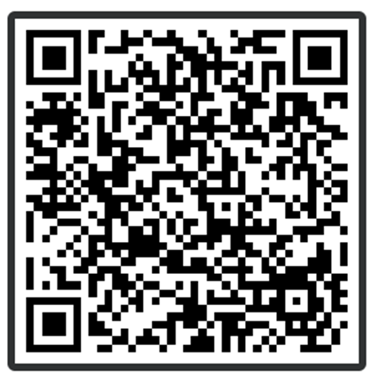
President Candidate Q&A
https://PollEv.com/discourses/NHCW4hkI6hsTNqyro8zMm/respond

Slide 15
Vice President of Internal Affairs
Candidates

Slide 16
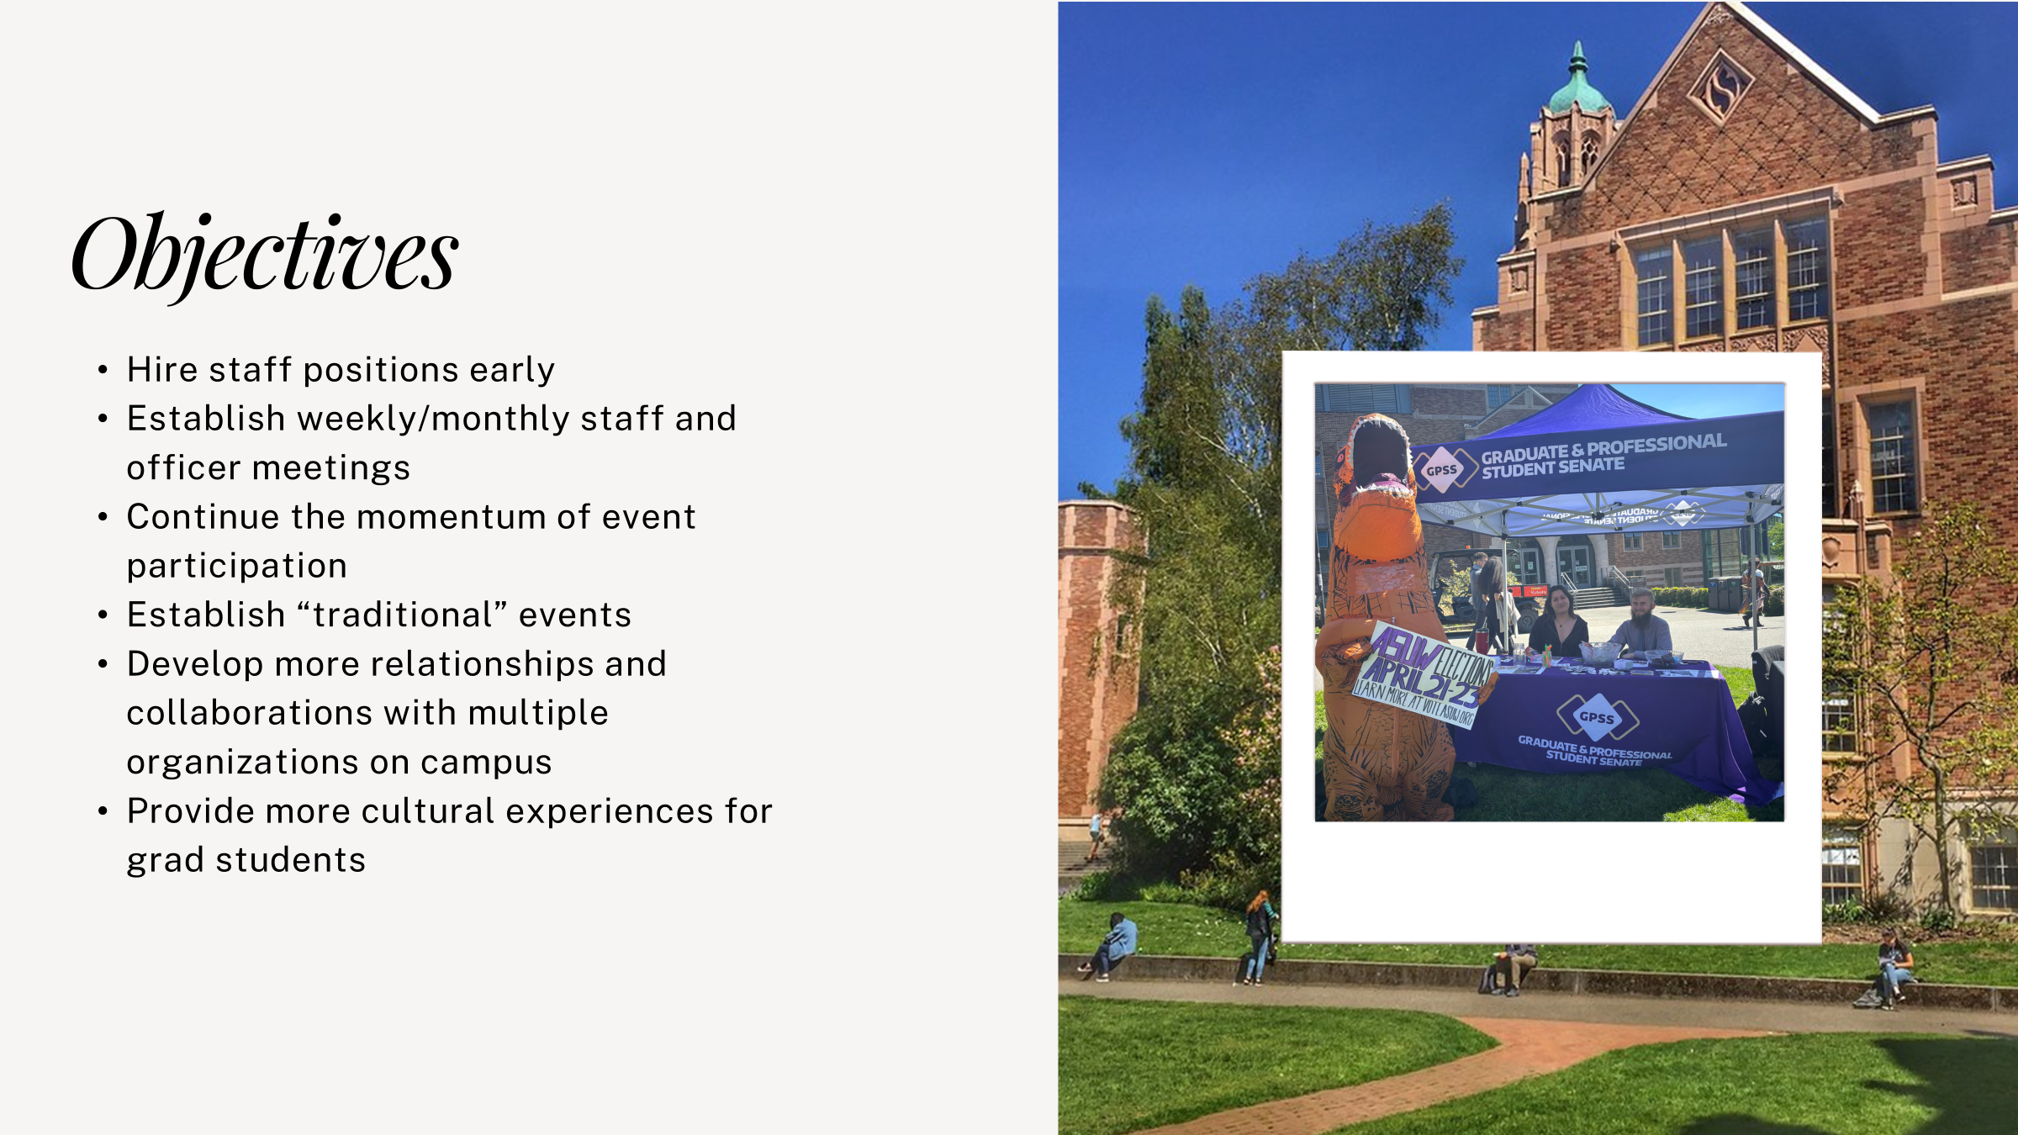

Slide 17
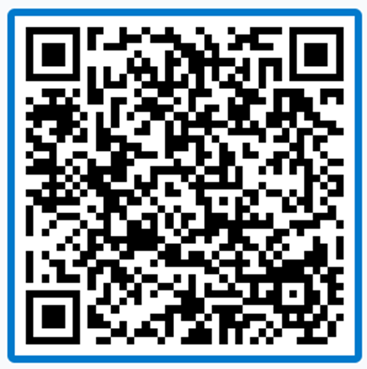
Vice President of Internal Affairs Q&A
https://PollEv.com/discourses/In1BNUcZBEwSUkXKrb0Ia/respond

Slide 18
Vice President of External Affairs
Candidates

Slide 19
Miles Parker

Slide 20
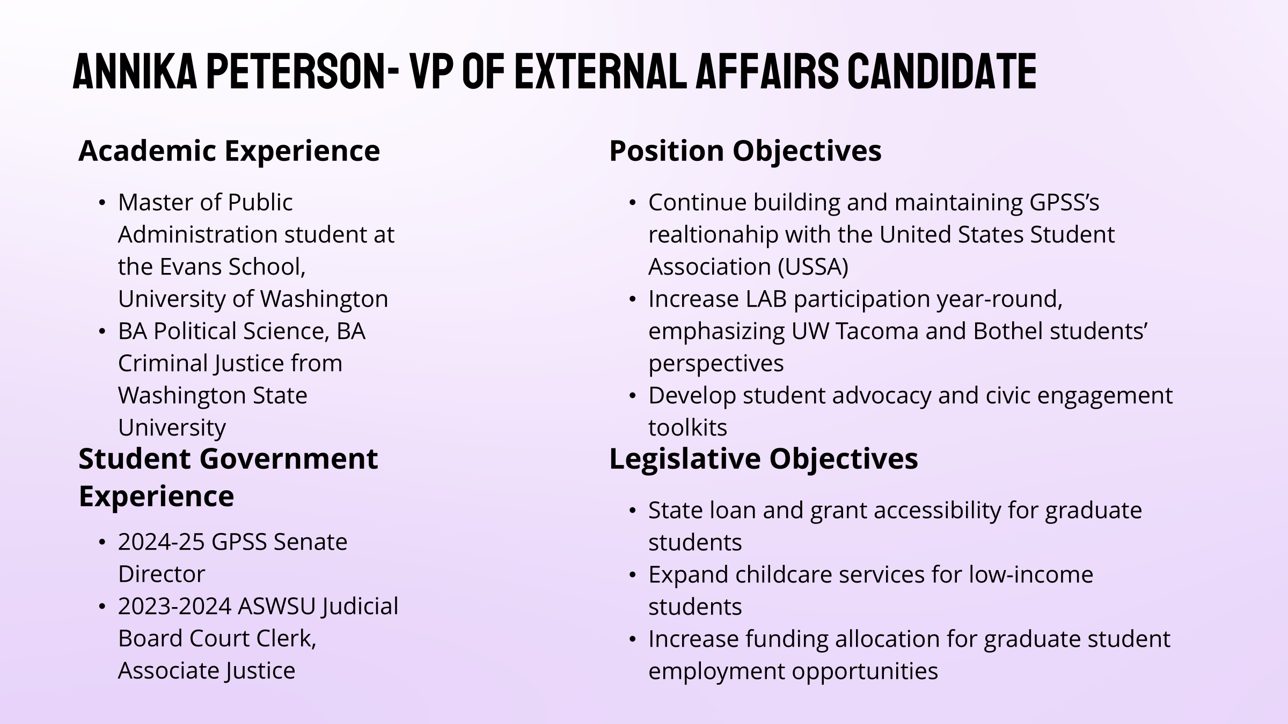

Slide 21
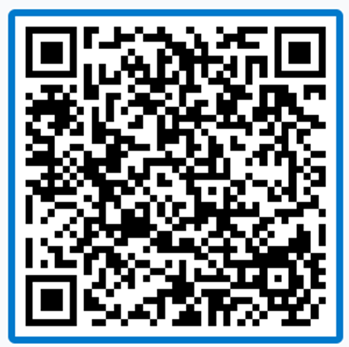
Vice President of External Affairs Q&A
https://PollEv.com/discourses/J9FQezMdOwvkNQQQ7MGcm/respond

Slide 22
Vice President of Equity and Inclusion
Candidates

Slide 23
Pavandeep Singh Josan

Slide 24
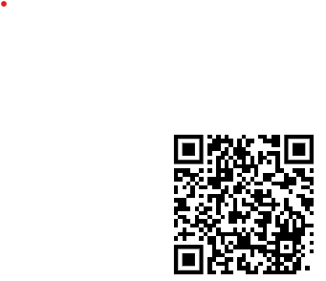
Vice President of Equity and Inclusion Q&A
https://PollEv.com/discourses/Z9r2sUUPrRx5LSlUanfgc/respond

Slide 25
Vice President of Administration
Candidates

Slide 26
Noah Nguyen Hough

Slide 27
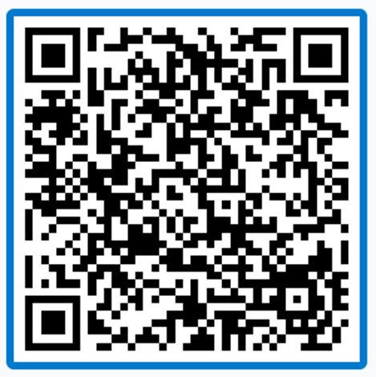
Vice President of Administration Q&A
https://PollEv.com/discourses/2HUyClXFZBx1znofF8upl/respond

Slide 28
Vice President of Finance
Candidates

Slide 29
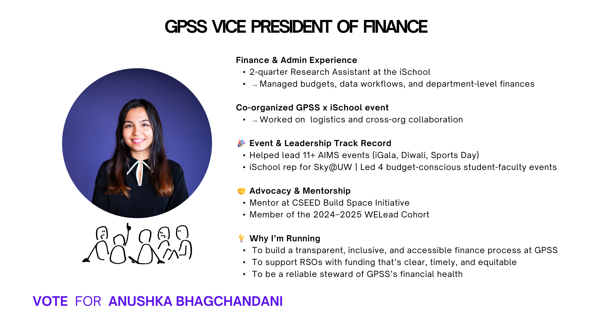

Slide 30
Vice President of Finance Q&A
https://PollEv.com/discourses/CQVuvZDDLxikZR9KBWdqB/respond

Slide 31
GPSS Election Candidate Discussion
30 min.

Slide 32
GPSS 2025 – 2026 Election Voting
15 min.

Slide 33
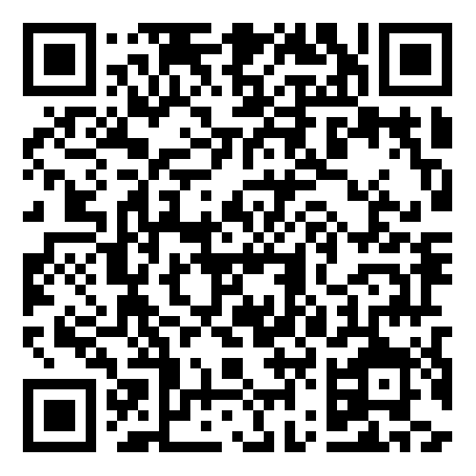
GPSS 2025-2026 Officer Ballot
Link: https://huskylink.washington.edu/submitter/election/start/685949

Slide 34
GPSS 2025 – 2025 Election Results
5 min.

Slide 35
Resolution in Calling on University Administrators to Speak Out About Federal Funding Cuts and Overreach
20 min.

Slide 36
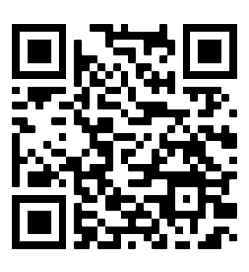
Resolution in Calling on University Administrators to Speak Out About Federal Funding Cuts and Overreach
You may review the Resolution using this link (Log in with UW account)
GPSS Resolution - Calling on University Administration to Speak Out About Federal Funding - Google Docs

Slide 37
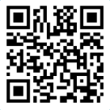
Resolution in Calling on University Administrators to Speak Out About Federal Funding Cuts and Overreach
Please vote using this form (log in with UW account)
https://forms.office.com/r/kkwkgNQ96A

Slide 38
Resolution to Support the Reinstatement of The Hooding Ceremony of the Graduate Programs at University of Washington, Bothell
15 min.

Slide 39
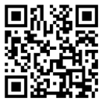
Motion to Suspend the Rules
25 min
Please vote using this form (log in with UW account)
https://forms.office.com/r/s55zRCSfUA
Notes:
richard

Slide 40
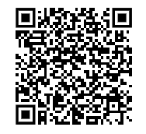
Resolution to Support the Reinstatement of The Hooding Ceremony of the Graduate Programs at University of Washington, Bothell
You may review the Resolution using this link (Log in with UW account)
Resolution to Support the Reinstatement of The Hooding Ceremony of the Graduate Programs at University of Washington, Bothell.docx

Slide 41
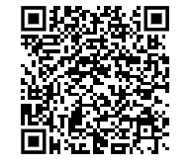
Resolution to Support the Reinstatement of The Hooding Ceremony of the Graduate Programs at University of Washington, Bothell
Please vote using this form (log in with UW account)
https://shorturl.at/U4vpm

Slide 42
Senator of the Month
5 min
Notes:
richard

Slide 43
Congratulations, Derek!
Thank you for your great work and dedication to GPSS!

Slide 44
Adjournment
1 min
Notes:
richard

Slide 45






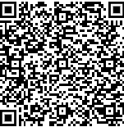


Follow us on Instagram :)
Join GPSS Senator Group on Teams

