Slide 1
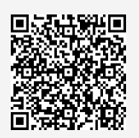
UNIVERSITY OF WASHINGTON
GRADUATE & PROFESSIONAL
STUDENT SENATE
SafeCampus (206-685-7233)
Call SafeCampus anytime to anonymously discuss safety and well-being concerns for yourself or others.
https://www.washington.edu/safecampus/
Childcare Assistance Program
https://www.washington.edu/financialaid/types-of-aid/child-care-assistance/
UW Food Pantry
https://www.washington.edu/anyhungryhusky/the-uw-food-pantry/
Student Technology Loan Program
The Student Technology Loan Program (STLP) is a free, student-led program that supports the academic technology needs of UW Seattle students
https://stlp.uw.edu/
Attendance Form
(Word of the Day: Autumn)
Attendance Form Link:
https://forms.office.com/r/RffiAbRpr6

Slide 2
Call To Order
1 min
Notes:
remind the Senate that all votes will be public. Zoom attendees should privately message VP of Admin with questions. Mention that there will be CART captioning for the meeting

Slide 3
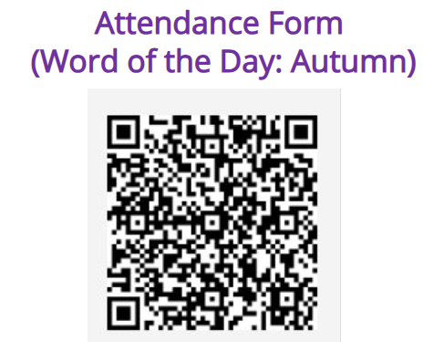
1. Call to Order (Sponsor: Richard Schure, Time: 1 min.) [ACTION]
2. Approval of Agenda (Sponsor: Richard Schure, Time: 1 min.) [ACTION]
3. Land Acknowledgement (Sponsor: [Edith Dale] Time: 2 min.) [INFORMATION]
4. Announcements (Sponsor: Richard Schure, Time: 7 min.) [INFORMATION]
5. Memorandum Congratulating Dr. David Baker on Nobel Prize in Chemistry (5 min.) [INFORMATION]
6. Senate Icebreaker (Sponsor: [Ella Spurlock and Kana Saarni], Time: 20 min.) [INFORMATION]
7. Introduction to GPSS (Sponsor: Richard Schure, Time: 7 min.) [INFORMATION]
8. Senate Overview and How-To's (Sponsor: Noah Hough, Time 20 min.) [INFORMATION]
9. Resolution on Washington State Ballot Initiative Measures (First Reading, Second Reading, and Third Reading /Vote) (Sponsor: Ella Spurlock, Mykhail Lembke Time: 20 min) [ACTION]
10. Legislative Agenda Draft (First Reading/Second Reading) (Sponsor: Mykhail Lembke Time: 15 min) [ACTION]
11. Officer Updates (Sponsor: Richard Schure, Time 10 min.) [INFORMATION]
12. Committee Formation (Sponsor: Richard Schure, Time: 20 min.) [POSSIBLE ACTION]
13. Executive Senator Positions (Sponsor: Richard Schure, Time: 3 min.) [INFORMATION]
14. Adjournment (Sponsor: Richard Schure, Time: 1 min.) [ACTION]
Approval of Agenda
1 min
Total Time: 132 minutes
Anticipated End Time: 7:42PM
Attendance Form Link:
https://forms.office.com/r/RffiAbRpr6

Slide 4
Land Acknowledgement
2 min
Notes:
Edith - Every community owes its existence and vitality to generations from around the world who contributed to making the history that led to this moment. Indigenous People have lived here continuously since time immemorial, and Seattle is now a highly cosmopolitan territory with overlapping sovereignties and fidelities. Acknowledging the land we are on is only the first step. Therefore the Graduate and Professional Student Senate at the University of Washington in Seattle acknowledges the Coast Salish peoples of this land, the land which touches the shared waters of all tribes and bands within the Suquamish, Tulalip, and Muckleshoot nations and all traditional lands on which we learn and work.

Slide 5
Within UW: - Get involved with LAB and the WSA! GPSS has advocated for a tuition waiver program for Native American students!
- wǝɫǝbʔaltxʷ - UW Intellectual House - https://www.washington.edu/diversity/intellectual-house/ - ASUW American Indian Student Commission (AISC): http://aisc.asuw.org Community: - Native and Strong Lifeline – 988 (option 4) The Native and Strong Lifeline is the first program of its kind in the nation dedicated to serving American Indian and Alaska Native people. Operated by Volunteers of America Western Washington, this line is available for people who call the 988 Lifeline and choose option 4. It is specifically for Washington’s American Indian and Alaska Native communities. Calls are answered by Native crisis counselors who are tribal members and descendants closely tied to their communities. Native and Strong Lifeline counselors are fully trained in crisis intervention and support, with special emphasis on cultural and traditional practices related to healing. - Stand with the Duwamish: https://www.duwamishtribe.org/stand-with-the-duwamish - Real Rent Duwamish: https://www.realrentduwamish.org
Resources for Action
Notes:
Edith - Washington Student Association

Slide 6
Announcements
3 min

Slide 7
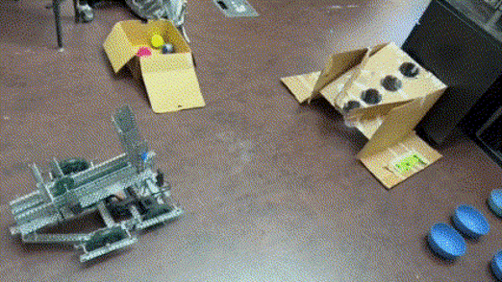
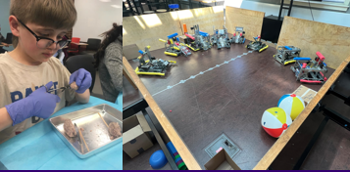
W25 Saturday Teaching UW Robinson Center
Notes:
AJ

Slide 8
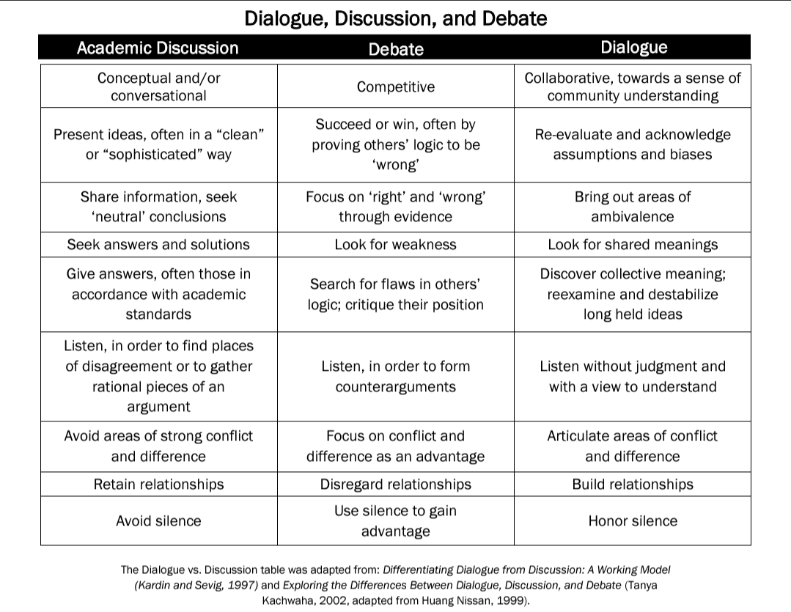
Sustained Dialogue
https://sustaineddialogue.org/
First meeting:
Wednesday, 10/30, 5:30 PM
HUB 314
For more information, contact:
Beth Fawcett, eafawc@uw.edu
Clare Koesters, ckoest@uw.edu
Notes:
Claire

Slide 9
GPSS Senator DEI Workshop
Wednesday,
November 20th
^{12:00PM- 1:30PM}
^{Lunch will be provided!}
Notes:
Edith

Slide 10
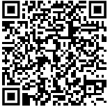
RSVP by November 13
Join us for a night of dialogue, advocacy, and community building! Celebrate the passage of our Legislative Agenda with elected officials, enjoy a catered dinner, and discuss student issues. Business Casual attire required.
Notes:
Mykhail

Slide 11
Get Out The Vote
Register to vote and come ask questions about the upcoming election!
GPSS, ASUW and OGR will host another voter registration drive next week! October 21, 2024 from 5 - 7pm in HUB 145
Professional headshots will be provided
More details on our Instagram tomorrow!

Slide 12
Notes:
Mykhail

Slide 13
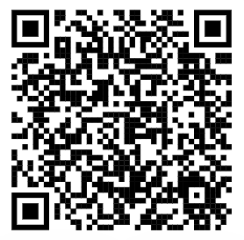
UW Resources for 2024 Election
More information at
https://www.washington.edu/provost/2024election/
Leading up to the 2024 election, UW faculty members will share their expertise through a public lecture on an election-related topic. The series spans UW partners, including the College of Arts & Sciences, the Evans School, the School of Law, and the Information School, with support from the Office of the Provost.
Notes:
Mykhail

Slide 14
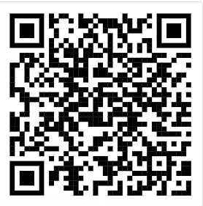
HUB Birthday Party
Friday,
October 25th,
^{11:30 AM – 1:00 PM}
Join us for an awesome HUB Birthday Party! We will have a brief program, followed by a performance from the Husky Marching Band at noon, an appearance by Dubs, giveaways of HUB-branded tshirts and tote bags*, FREE HUB Birthday cupcakes* and more. Get your photo with UW's awesome mascot Dubs, grab some merch and a treat and sing along when the band plays "Happy Birthday" to the HUB. ^{*while supplies last.}
More events at
https://hub.washington.edu/celebrate75/
Notes:
Noah

Slide 15
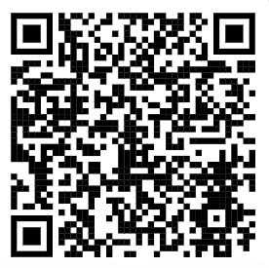
Meany Hall Performances
Scan QR code to see events schedule!
Notes:
Noah

Slide 16
HUB Excellence in Student Leadership Scholarship
The 2024 application is now open:
https://forms.office.com/r/APKa7E3m8B
The HUB Excellence in Student Leadership Scholarship supports HUB student leaders in reaching their full potential as campus leaders, regardless of financial situation.
Four scholarships will be awarded this year. Involvement and financial need will be factors in the selection. The recipients of the award will receive $2,000 for Fall 2024.
Deadline for applications: October 31, 2024 at 11:59PM.
Questions? Email thehub@uw.edu
Notes:
Noah

Slide 17
Notes:
Noah

Slide 18
UW Public Lectures
https://www.washington.edu/lectures/
Notes:
Noah

Slide 19
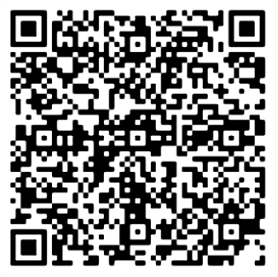
Events
Notes:
Kana

Slide 20
GPSS Football Night UCLA v. UW
Friday,
November 15th
^{6:00 PM - 9:00 PM}
GPSS Official Pregame – 4:00 PM – 6:00 PM
Free Pizza & Drinks (21+) Provided
Tickets - $38.65 (including taxes/fees)
Notes:
kana

Slide 21
GPSS Weekly Coffee Chats
Wednesdays
12:00 – 5:00 PM
Pop-by before senate and chat with officers/staff or grab some free coffee!
Notes:
kana

Slide 22
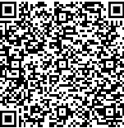
Follow us on Instagram :)
Join GPSS Senator Group on Teams
Notes:
kana

Slide 23
Memorandum Congratulating Dr. David Baker on Nobel Prize in Chemistry
5 min
Notes:
ella

Slide 24
Senate Icebreaker
20 min
Notes:
Ella / kana

Slide 25
Introduction to GPSS
7 min
Notes:
Mission: GPSS amplifies the voices and experiences of graduate and professional students at the University of Washington, builds community, and advocates for the
eradication of inequities that exist within institutionalized academic settings.

Slide 26
WE ADVOCATE for the needs and interests of our constituents WE PROMOTE professional development and foster a sense of community and connection WE AMPLIFY graduate and professional student voices and experiences WE ASPIRE to eradicate inequities existing within institutionalized academic settings
ABOUT GPSS
Notes:
So what are we, what do we do, and why should you care about us? GPSS is the governing body that services the needs and interests of over 16,000 graduate and professional students at the University of Washington, representing a crucial piece of the University’s shared governance system: WE ADVOCATE for the needs and interests of our constituents on campus and at the state and federal levels. WE PROMOTE professional development and foster a sense of community and connection through our events, programming, and funding opportunities. WE AMPLIFY graduate and professional student voices and experiences to ensure our shared values are upheld at all levels of university decision-making. WE ASPIRE TO ERADICATE inequities existing within institutionalized academic settings that inhibit an equitable, inclusive community within the university.

Slide 27
GPSS Officers
We are here to support you!
President: Richard Schure (he/him)
gpsspres@uw.edu
VP of Internal Affairs: Kana Saarni (she/hers)
gpssvpin@uw.edu
VP of External Affairs: Mykhail Lembkey (he/him)
gpssvpex@uw.edu
VP of Equity & Inclusion: Edith Dale (she/hers)
gpssvpei@uw.edu
VP of Finance: Ryan Wicklund (he/him)
gpssvpfb@uw.edu
VP of Administration: Noah Hough (she/hers)
gpssvpadmin@uw.edu

Slide 28
Judicial *
Leadership
UW Graduate and Professional Students
Staff
Graduate and Professional Student Senators
Elections *
Committees
Graduate and Professional Student Senate Executive Committee
Liaisons
President
Vice President of Internal Affairs
Vice President of External Affairs
Vice President of Equity and Inclusion
Vice President of Administration
Vice President of Finance
University Affairs Director
Communications and Creative Director
Policy Director
Community Outreach & Events Director
Office & Budget Director
Office & Budget Director
Web Developer
Finance and Budget *
Senate Director
Legislative Advisory Board (LAB)
Senate Director
Science & Policy
Diversity Committee (EDA)
Travel Grants
Arts Council
Senators Motivation and Recruitment/Retention (CSMR)
Notes:
This is a more detailed breakdown of GPSS dynamics. Take note of the many Committees, all of which, except those with asterisks, are open to any graduate and professional student, not just Senators. While GPSS meetings and functions are primarily in-person, GPSS is still committed to hybrid accessibility. Now that you’ve had this little tour of who we are, you’re still probably wondering what exactly we do.

Slide 29
COMMITTEES
Legislative Advisory Board (LAB)
Diversity Committee
Science & Policy
Travel Grants
Arts Council
Committee for Senators Motivation and Retention (CSMR)
Judicial
Elections
Finance & Budget
*Highlighted committees are only open to GPSS Senators
Notes:
Our GPSS Committees play a vital role in the functioning of GPSS, as well as representing an opportunity for wider graduate student involvement than just Senate. We rely heavily upon willing and committed graduate and professional students who want to make an impact to join our various committees because of this. Outside of the three highlighted, these committees are open to all graduate and professional students: The Legislative Advisory Board (LAB) develops the aforementioned Legislative Agenda ahead of Winter Quarter’s legislative session in Olympia and assists with lobbying, advocacy, and student organizing efforts. The Diversity Committee awards diversity funds and collaborates with other campus diversity events and programs, as well as developing their own. This Committee is being reinforced and restructured to better reflect the importance of this work, and we appreciate feedback on how it should continue to support students. The Science & Policy Committee enhances the discourse between scientists and policy makers through advocacy and student empowerment.
The Travel Grant Committee allocates $25,000 in travel grants to graduate students for participation in academic/professional conferences. The Arts Council advocates specifically for the arts and humanities, which are not always a priority in university discussions and decision-making. Likewise, it fosters a community of support and collaboration among graduate students in the arts and humanities.
The Committee for Senators Motivation and Retention (CSMR) is a new committee whose mission is to find ongoing and relevant ways to motivate Senators, promote Senator retention, and recognize Senators’ work in GPSS.
The Committees only open to GPSS Senators include: The Elections Committee, which oversees the elections process for next years Officers in Spring Quarter, the Finance & Budget Committee, which develops the annual GPSS Budget and oversees Departmental and Special Allocations, and the Judicial Committee, which investigates and manages grievances concerning the internal workings of GPSS such as compliance with our Constitution or Bylaws and grievances against Officers or Senators.

Slide 30
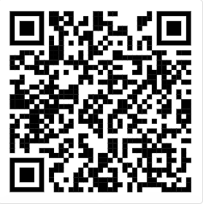
LIAISONS
Student Technology Fee (3 openings)
Services and Activities Fee (4 openings)
Provost’s Advisory Committee for Students (1 opening)
Campus Sustainability Fund (2 openings)
Library Fine Appeals (1 opening)
U-PASS Advisory Board (3 openings)
Faculty Councils (12 different openings)
Application Form
https://forms.office.com/r/iuKKKsG1Lw
Advocating for the needs of Graduate and Professional students across campus
Notes:
In addition to the members of our internal committees, GPSS appoints Liaisons to university committees, groups, and boards and is also a vital strategy for successful operations through their a role in shaping policies that impact graduate students. As a Liaison, you have the opportunity to advocate for graduate and professional students across campus in roles that vary in scope and interest. For instance, you may contribute to policies that impact transportation (U-PASS Advisory Board), create changes in Diversity, Equity, and Inclusion, or even impact how our technology and activity fees are spent (SAF and STF). Your perspective matters: we encourage you to share yours as a Liaison, especially if you want to get involved and may not be able to attend Senate meetings or take on the responsibilities of a Senator.

Slide 31
Senate Overview and How-to's
7 min
Notes:
Noah - move to suspend parliamentary procedure for this information item.

Slide 32
- Please raise your hand (physically or digitally) when you wish to speak and wait to be recognized by the chair. -When speaking, please begin by stating your name and your department. For example, "Noah Hough, VP of Administration" or "John Doe, Senator, Materials Science and Engineering Department." This helps our Senate, CART Captioner, and Senate Director keep track of who is speaking and making motions - Please try to keep your comments relevant to the agenda item at hand; likewise, try to avoid repeating information that has already been discussed. This helps respect everyone's time and keep our meeting punctual. - Please maintain high standards of professional honesty and integrity, and respect the rights, privileges, and property of other members of the GPSS.
General Senate Guidelines
Notes:
Noah

Slide 33
Sturgis = Standard Code of Parliamentary Procedure
We conduct meetings in Sturgis’s Parli Pro to:
have order in our meetings
to be respectful of all people’s time and ideas
It ensures Senators and recognized guests have the opportunity to speak about items on our agenda and, in the case of Senators, to have their votes counted.
We also want people to be comfortable and will assist with how to make motions.
Parliamentary Procedure
Notes:
Noah
GPSS follows the
guidelines of Sturgis’s Standard Code of Parliamentary Procedure. Senators not to feel discouraged from participating in Senate meetings if they do not feel
familiar with parliamentary procedure. distinguishing between
Information and Action items on an agenda. directed Senators to the “cheat sheet” for
motion verbiage. presentation on the meanings and uses of “Point of
Information,” “Point of Order,” “Point of Privilege,” making a motion, and the power to
object

Slide 34
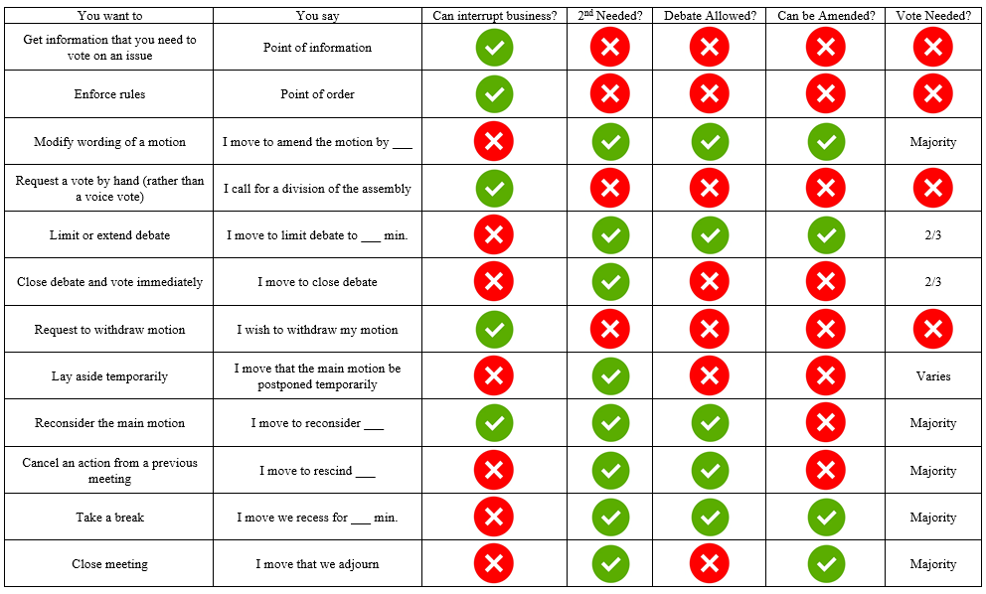
Some Highlights: - Point of Information - Point of Order - Point of Privilege - Making a Motion - The power to object - “Order” - “Cheat sheets”
Parliamentary Procedure
Notes:
noah

Slide 35
Let's try it out!
Parliamentary Procedure
Scenario 1: Someone is speaking, and they keep mentioning "ALISS," but you don't know what "ALISS" means. What should you do?
Scenario 2: The room has gotten so unbelievably warm that you're unable to focus on the meeting any longer. What can you do?
Notes:
noah

Slide 36
Parliamentary Procedure
Scenario 4: A resolution has just been read, and you think that it should be approved by the Senate and put into action. What can you do?
Scenario 3: Someone has moved that we move to a vote on the issue we're considering. It has been seconded, and there are no objections; however, someone also makes a motion to go recess for 10 minutes. The chair asks for a second for the motion to recess. What can you do?
Notes:
Noah

Slide 37
Resolution Writing
Have a great idea of how graduate and professional students can work to make our University a better place?
You can write or sponsor a resolution!
Past resolutions:
Resolution to Support Student Wellbeing and Academic Success During Complex Humanitarian Crises
Resolution to Expedite the University of Wahington's Decarbonization Plan
Resolution Calling for Research into Alternatives for Toxic Chemicals
Notes:
Noah

Slide 38
Notes:
Noah

Slide 39
Resolution on 2024 Washington State Ballot Initiative Measures
20 min
Notes:
normally the Senate would
discuss and amend a resolution after the first reading, and that a second reading and
subsequent Senate vote on a resolution would happen at the next Senate meeting after a
resolution’s author makes the agreed upon revisions. He explained that because this
resolution is time-sensitive, the officers prefer to move to a second reading so that the
Senate can vote on the Resolution

Slide 40
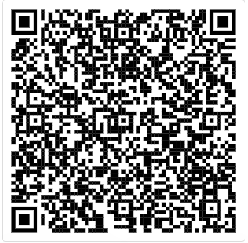
Resolution on 2024 Washington State Ballot Initiative Measures You may review the Resolution using this link (log in with UW account)
https://shorturl.at/HQT3a

Slide 41
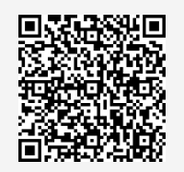
Motion to Suspend the Rules
Because this resolution is time-sensitive, this motion will allow to move to a second/third reading so that the Senate can vote on the Resolution at this meeting.
https://forms.office.com/r/nmuA2K41aB

Slide 42
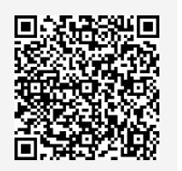
Resolution on 2024 Washington State Ballot Initiative Measures Please vote using this form (log in with UW account)
https://forms.office.com/r/JPeeHMXMJj

Slide 43
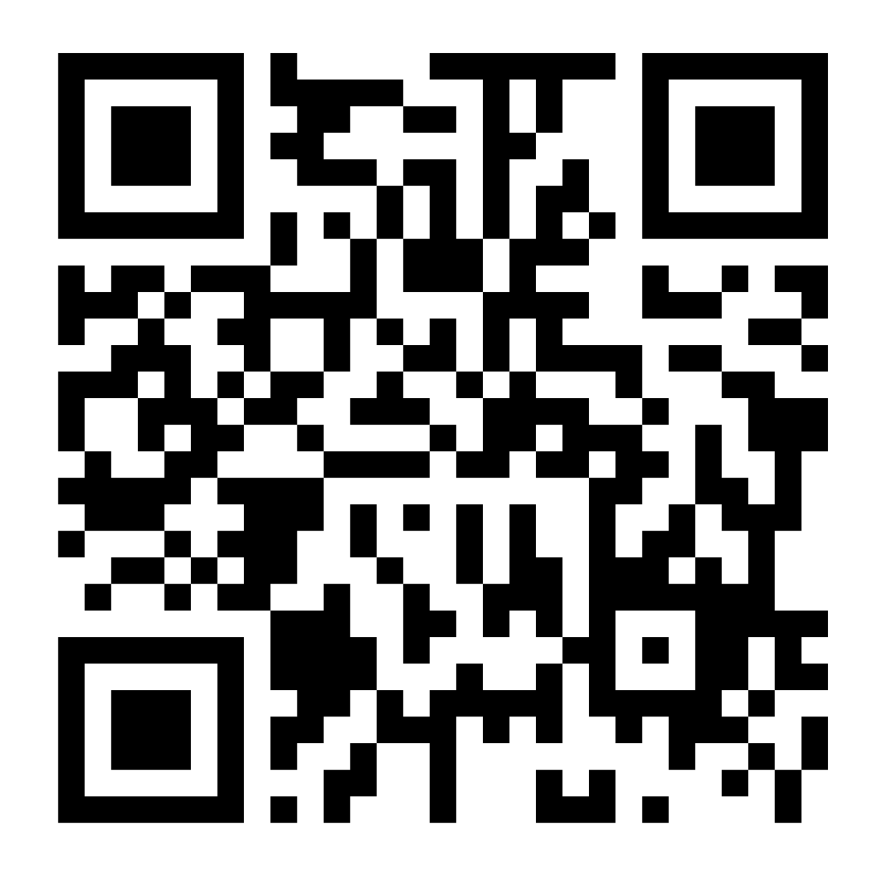
Legislative Agenda Draft
15 min
Scan to complete the 2024-2025 GPSS Legislative Agenda Survey
Notes:
https://shorturl.at/UGQWY

Slide 44
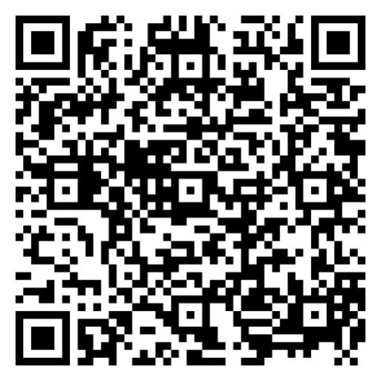
Legislative Agenda You may review the agenda using this link (log in with UW account) https://shorturl.at/UGQWY
Notes:
https://shorturl.at/UGQWY

Slide 45
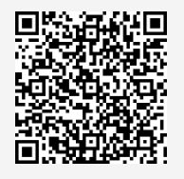
Motion to Suspend the Rules
Because this is time-sensitive, this motion will allow to move to a second reading so that the Senate can edit today, and vote on the Resolution at the next meeting.
https://forms.office.com/r/5m5uJBJW6T

Slide 46
Officer Updates
10 min
Notes:
President (Pres)
Vice President of Internal Affairs (VPIN)
Vice President of External Affairs (VPEX)
Vice President of Equity and Inclusion (VPEI)
Vice President of Administration (VPA)
Vice President of Finance (VPFB)

Slide 47
Committee Formation
20 min
Notes:
Richard

Slide 48
Three GPSS Committees require its members to be Senators and to be confirmed: Judicial Committee Elections Committee Finance and Budget (F&B) Committee
Committee Formation
Notes:
Richard

Slide 49
Judicial Committee
Composition:
GPSS VP of Equity and Inclusion
SAO Advisor
Six (6) elected Senators
All Senators are encouraged to run for the position. Nominations (including self-nominations) may be taken from the floor. Each candidate will deliver brief remarks followed by voting process.
Voting Judicial Committee members shall not sit on the Executive, Finance and Budget, or Elections Committees.
Officer candidates shall resign from the voting Judicial Committee position 35 days prior to the Officer Elections
Functions:
Act as a standing investigative body to investigate any grievance that arises concerning an interpretation of the GPSS Constitution and Bylaws, or concerning any procedure, committee, Officer, Officer candidate, or Senator of the GPSS.
*Only for currently registered Senators
Notes:
richard

Slide 50
Finance & Budget Committee
Composition:
GPSS VP of Finance
Director of Student Activities and Union Facilities, or the Director’s designee
Five-to-nine (5-9) elected Senators, who
apply and be interviewed by the President and/or the Vice President of Finance
shall be appointed by the President and approved by a majority vote of the Executive Committee
*Only for currently registered Senators
Notes:
richard

Slide 51
Finance & Budget Committee (cont.)
Functions:
Assume responsibility for the allocation of GPSS Grant Budget from the previous Finance and Budget Committee
Advertise, review, and approve special and departmental requests (with exceptions)
Review and recommend an annual budget to the GPSS for the following fiscal year
Follow and revise the “Special and Departmental Allocation Funding Packet.”
*Only for currently registered Senators
Notes:
richard

Slide 52
Elections Committee
Composition:
At least four (4) at-large Senators in good standing
One (1) Executive Senator
Members of the Elections Committee may not be current GPSS Officers or candidates for an Officer position.
Committee members who decide they want to run for an Officer position must resign from the Elections Committee at least 35 days before the Officers Elections.
*Only for currently registered Senators
Notes:
richard

Slide 53
Elections Committee (cont.)
Functions:
Ensures GPSS elections are fair, transparent, and inclusive, following the Bylaws and Constitution.
Adopt the GPSS Elections Rules in accordance with the Constitution and Bylaws and produce an Elections Guide.
Conduct all GPSS elections in accordance with the GPSS Election Rules. The committee may terminate an individual’s candidacy for violations of the GPSS Election Rules.
*Only for currently registered Senators
Notes:
richard

Slide 54
Legislative Advisory Board
(LAB) Committee
Functions
Assists the Vice President of External Affairs in developing a legislative agenda for Winter Quarter’s legislative session
Advise and assist the Vice President of External Affairs on issues related to the GPSS’s lobbying efforts and in particular Graduate Student on Day on the Hill (Huskies on the Hill)
Assist with lobbying during the interim Spring, Summer, and Fall quarters
Meetings
Autumn Quarter: Mondays, 3:00 PM to 4:00PM in HUB 303
*Open to Everyone
Contact: Mykhail Lembke, gpssvpex@uw.edu
Notes:
mykhail

Slide 55
Diversity Committee
Functions
Undertake strategic actions to eradicate the historical inequities inherent in institutionalized academic structures and settings;
Establish criteria for and award grants from the GPSS Diversity Funds;
Annually conduct GPSS Composition Surveys;
Plan, host, and promote campus-wide events and programming on diversity issues;
Collaborate with students, faculty, administration, staff, and others on diversity programming, events, and activities;
Facilitate communication between the GPSS and graduate and professional students working on diversity issues within their department, college, or school;
Hear grievances concerning inequities existing along lines of difference including, but not limited to, racism, homophobia, sexism, ableism, bigotry, and xenophobia, and refer grievances or complaints to the Judicial Committee for investigation when applicable under Article VI, Section B, Clause 2, subsection a.
Meetings
Autumn Quarter: Fridays at 12:30PM (starting October 25th)
*Open to Everyone
Contact: Edith Dale, gpssvpei@uw.edu
Notes:
Edith
This Committee addresses historical inequities in academia, awards Diversity Fund grants, and conducts annual composition surveys. It collaborates on diversity events and programming, while facilitating communication between GPSS and students working on diversity issues.

Slide 56
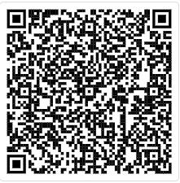
Travel Grants Committee
Functions
Assist the Treasurer in communicating policies and procedures governing the Travel Grants process
Assist the Treasurer in advertising the availability of Travel Grants to the GPSS Senators and other graduate and professional students
Review and recommend an annual Travel Grants budget to the Finance and Budget Committee for the following fiscal year.
Meetings
Autumn Quarter:
Tuesdays, 7:00 PM – 8:00 PM, on Zoom
Apply Now:
GPSS Travel Grant Committee Interest Form (office.com)
*Open to Everyone
Contact: Ryan Wicklund, gpssvpfb@uw.edu
Notes:
ryan

Slide 57
Science & Policy Committee
Functions
Assist student scientists in developing their skills in communication across disciplines and to the general public and promote public awareness of science research at the University of Washington, by providing opportunities to develop partnerships in the UW and greater Seattle community
Create opportunities and organize science and events (GPSS Interdisciplinary Research Symposium) in collaboration with other GPSS committees, UW organizations, and national organizations (such as the National Science and Policy Group) as needed.
Meetings
Autumn Quarter: TBD
*Open to Everyone
Contact: Ella Spurlock, espurloc@uw.edu
Notes:
ella

Slide 58
Arts Council
Functions
The Arts Council creates a space for students in the arts across campus to collaborate interdisciplinarily, develop a stronger community, and advocate for the improvement of issues recognized during Council meetings that affect students within the arts at UW.
Book Club
Knitting & Crochet Circle
Events
Meetings
Autumn Quarter:
Mondays, 4:00 PM – 5:00 PM, HUB 314
*Open to Everyone
Contact: Noah Hough, gpssvpadmin@uw.edu
Notes:
noah

Slide 59
Notes:
noah

Slide 60
Adhoc Committees
Ad hoc committees shall be temporary committees designed to address special issues identified by the GPSS.
Any Senator or Officer may propose the creation of an ad hoc committee, which then must be approved by a simple majority of the GPSS.
Committee for the Senators Motivation & Retention (CSMR)
Explore various acceptable ways aimed at motivating and encouraging graduate students and senators to volunteer their time and services to the work of the GPSS.
*Open to Everyone
Contact: Noah Hough, gpssvpadmin@uw.edu
Notes:
noah

Slide 61
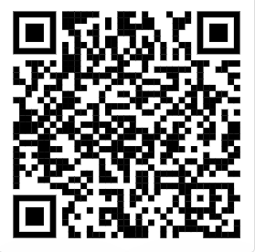
Fill out this form to get connected with committee(s) of your interest https://forms.office.com/r/fmUsMm9Ybp
Notes:
noah

Slide 62
Executive Senator Positions
3 min
Notes:
richard

Slide 63
Executive Senator Responsibilities: - Attend all regular GPSS Meetings (3-5 per quarter) - Attend Executive Committee Meetings (3-5 per quarter, including summers) - Choose your own adventure for getting more involved in GPSS—Chair a GPSS committee, form an ad hoc committee, sponsor and/or author resolutions, volunteer to assist with events, serve as an appointee on a University committee, etc. Executive Senators terms are two (2) years or until graduation, whichever comes first. They act as a crucial form of checks and balances, representing the Senate itself on the Executive Committee. They receive monetary recognition for their extra time commitments and responsibilities in the amount of $450 per quarter (Fall, Winter, and Spring), disbursed at the end of the Academic year.
There are five (5) Executive Senator Positions open!
Notes:
noah

Slide 64
Candidates may be nominated of self-nominated in advance to the VP of Administration (gpssvpadmin@uw.edu) via email, or they may be (self-)nominated in person, "from the floor" of the Senate during the election meeting. Each candidate will be given exactly three (3) minutes to speak to their interests in and qualifications for the positions at the election.
Executive Senator Elections
Notes:
noah

Slide 65
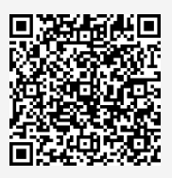
GPSS Executive Senator Election Voting
Vote at this link:
https://forms.office.com/r/eJzZyeMT4f
Notes:
noah

Slide 66
Adjournment
1 min
Notes:
richard

Slide 67
Follow us on Instagram :)
Join GPSS Senator Group on Teams

