Slide 1
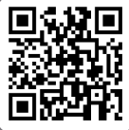
UNIVERSITY OF WASHINGTON
GRADUATE & PROFESSIONAL
STUDENT SENATE
SafeCampus (206-685-7233)
Call SafeCampus anytime to anonymously discuss safety and well-being concerns for yourself or others.
https://www.washington.edu/safecampus/
Childcare Assistance Program
https://www.washington.edu/financialaid/types-of-aid/child-care-assistance/
UW Food Pantry
https://www.washington.edu/anyhungryhusky/the-uw-food-pantry/
Student Technology Loan Program
The Student Technology Loan Program (STLP) is a free, student-led program that supports the academic technology needs of UW Seattle students
https://stlp.uw.edu/
Attendance Form
(Word of the Day: Friendship)
Attendance Form Link:
https://forms.office.com/r/ceUZeJJJ2w

Slide 2
Call To Order
1 min
Notes:
remind the Senate that all votes will be public. Zoom attendees should privately message VP of Admin with questions. Mention that there will be CART captioning for the meeting

Slide 3
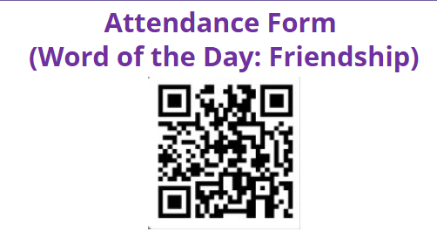
1. Call to Order (Sponsor: Richard Schure, Time: 1 min.) [ACTION]
2. Approval of Agenda (Sponsor: Richard Schure, Time: 1 min.) [ACTION]
3. Approval of Minutes (Sponsor: Richard Schure, Time: 1 min.) [ACTION]
4. Land Acknowledgement (Sponsor: [Edith Dale] Time: 2 min.) [INFORMATION]
5. Announcements (Sponsor: Richard Schure, Time: 15 min.) [INFORMATION]
6. Student Technology Fee (STF) (Sponsor: Richard Schure, Time: 5 minutes.) [INFORMATION]
7. Joy Williamson-Lott, the Dean UW Graduate School (Sponsor: Richard Schure, Time: 15 minutes) [INFORMATION]
8. Resolution Honoring the Legacy of Governor Daniel J. Evans (First Reading, Second Reading, and Third Reading /Vote) (Sponsor: Emilio Castaneda, Mykhail Lembke, Time: 10 min) [ACTION]
9. Legislative Agenda (Third Reading) (Sponsor: Mykhail Lembke, Time: 20 min) [ACTION]
10. Senator of the Month (Sponsor: Edith Dale, Time: 5 min) [INFORMATION]
11. Election and Judicial Committee Formation (Sponsor: Beth Fawcett, Richard Schure, Time: 15 min.) [POSSIBLE ACTION]
12. Committee Updates and Recruitment (Sponsor: Noah Hough, Charles Bugre, Ella Spurlock, Time: 20 minutes)
13. Executive Senator Positions (Sponsor: Richard Schure, Time: 10 min.) [POSSIBLE ACTION]
14. Adjournment (Sponsor: Richard Schure, Time: 1 min.) [ACTION]
Approval of Agenda
1 min
Total Time: 106 minutes
Anticipated End Time: 7:20 PM
Attendance Form Link:
https://forms.office.com/r/ceUZeJJJ2w

Slide 4
Minutes from the 10/16/2024 GPSS Meeting, as circulated by email by Senate Director Annika Peterson on 11/12/2024
Approval of Minutes
1 min
Attendance Form Link:
https://forms.office.com/r/ceUZeJJJ2w

Slide 5
Land Acknowledgement
2 min
Notes:
Edith - Every community owes its existence and vitality to generations from around the world who contributed to making the history that led to this moment. Indigenous People have lived here continuously since time immemorial, and Seattle is now a highly cosmopolitan territory with overlapping sovereignties and fidelities. Acknowledging the land we are on is only the first step. Therefore the Graduate and Professional Student Senate at the University of Washington in Seattle acknowledges the Coast Salish peoples of this land, the land which touches the shared waters of all tribes and bands within the Suquamish, Tulalip, and Muckleshoot nations and all traditional lands on which we learn and work.

Slide 6
Within UW: - Get involved with LAB and the WSA! GPSS has advocated for a tuition waiver program for Native American students!
- wǝɫǝbʔaltxʷ - UW Intellectual House - https://www.washington.edu/diversity/intellectual-house/ - ASUW American Indian Student Commission (AISC): http://aisc.asuw.org Community: - Native and Strong Lifeline – 988 (option 4) The Native and Strong Lifeline is the first program of its kind in the nation dedicated to serving American Indian and Alaska Native people. Operated by Volunteers of America Western Washington, this line is available for people who call the 988 Lifeline and choose option 4. It is specifically for Washington’s American Indian and Alaska Native communities. Calls are answered by Native crisis counselors who are tribal members and descendants closely tied to their communities. Native and Strong Lifeline counselors are fully trained in crisis intervention and support, with special emphasis on cultural and traditional practices related to healing. - Stand with the Duwamish: https://www.duwamishtribe.org/stand-with-the-duwamish - Real Rent Duwamish: https://www.realrentduwamish.org
Resources for Action
Notes:
Edith - Washington Student Association

Slide 7
Announcements
3 min

Slide 8
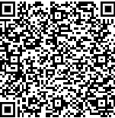
Follow us on Instagram
Join GPSS Senator Group on Teams
Notes:
kana

Slide 9
Washington Student Association Vice President of Graduate and Professional Student Affairs position, Jan-May 2025 1. Facilitate advocacy and awareness 2. Monitor legislation 3. Chair WSA's Graduate and Professional Student Committee Find the application on WSA's Instagram, apply by the 24th Email the current WSA VP any questions gradprofs@wastudents.org
Notes:
Ryan

Slide 10
Graduate Student Representative Needed for the HUB Board of Representatives! A unique leadership opportunity to make a difference: you’ll serve in an advisory role to the Executive Director of the HUB, helping to shape the vision, voice, and direction of the student union.
Meeting Schedule for 2024-2025: Location: HUB 303 (with a Zoom option)
November 18, 11am–12pm
February 27, 11am–12pm
May 22, 11am–12pm
Commitment: 3-6 meetings/ academic year
Additional meetings may be scheduled as needed.
To apply:
Reach out to Noah at gpssvpadmin@uw.edu

Slide 11
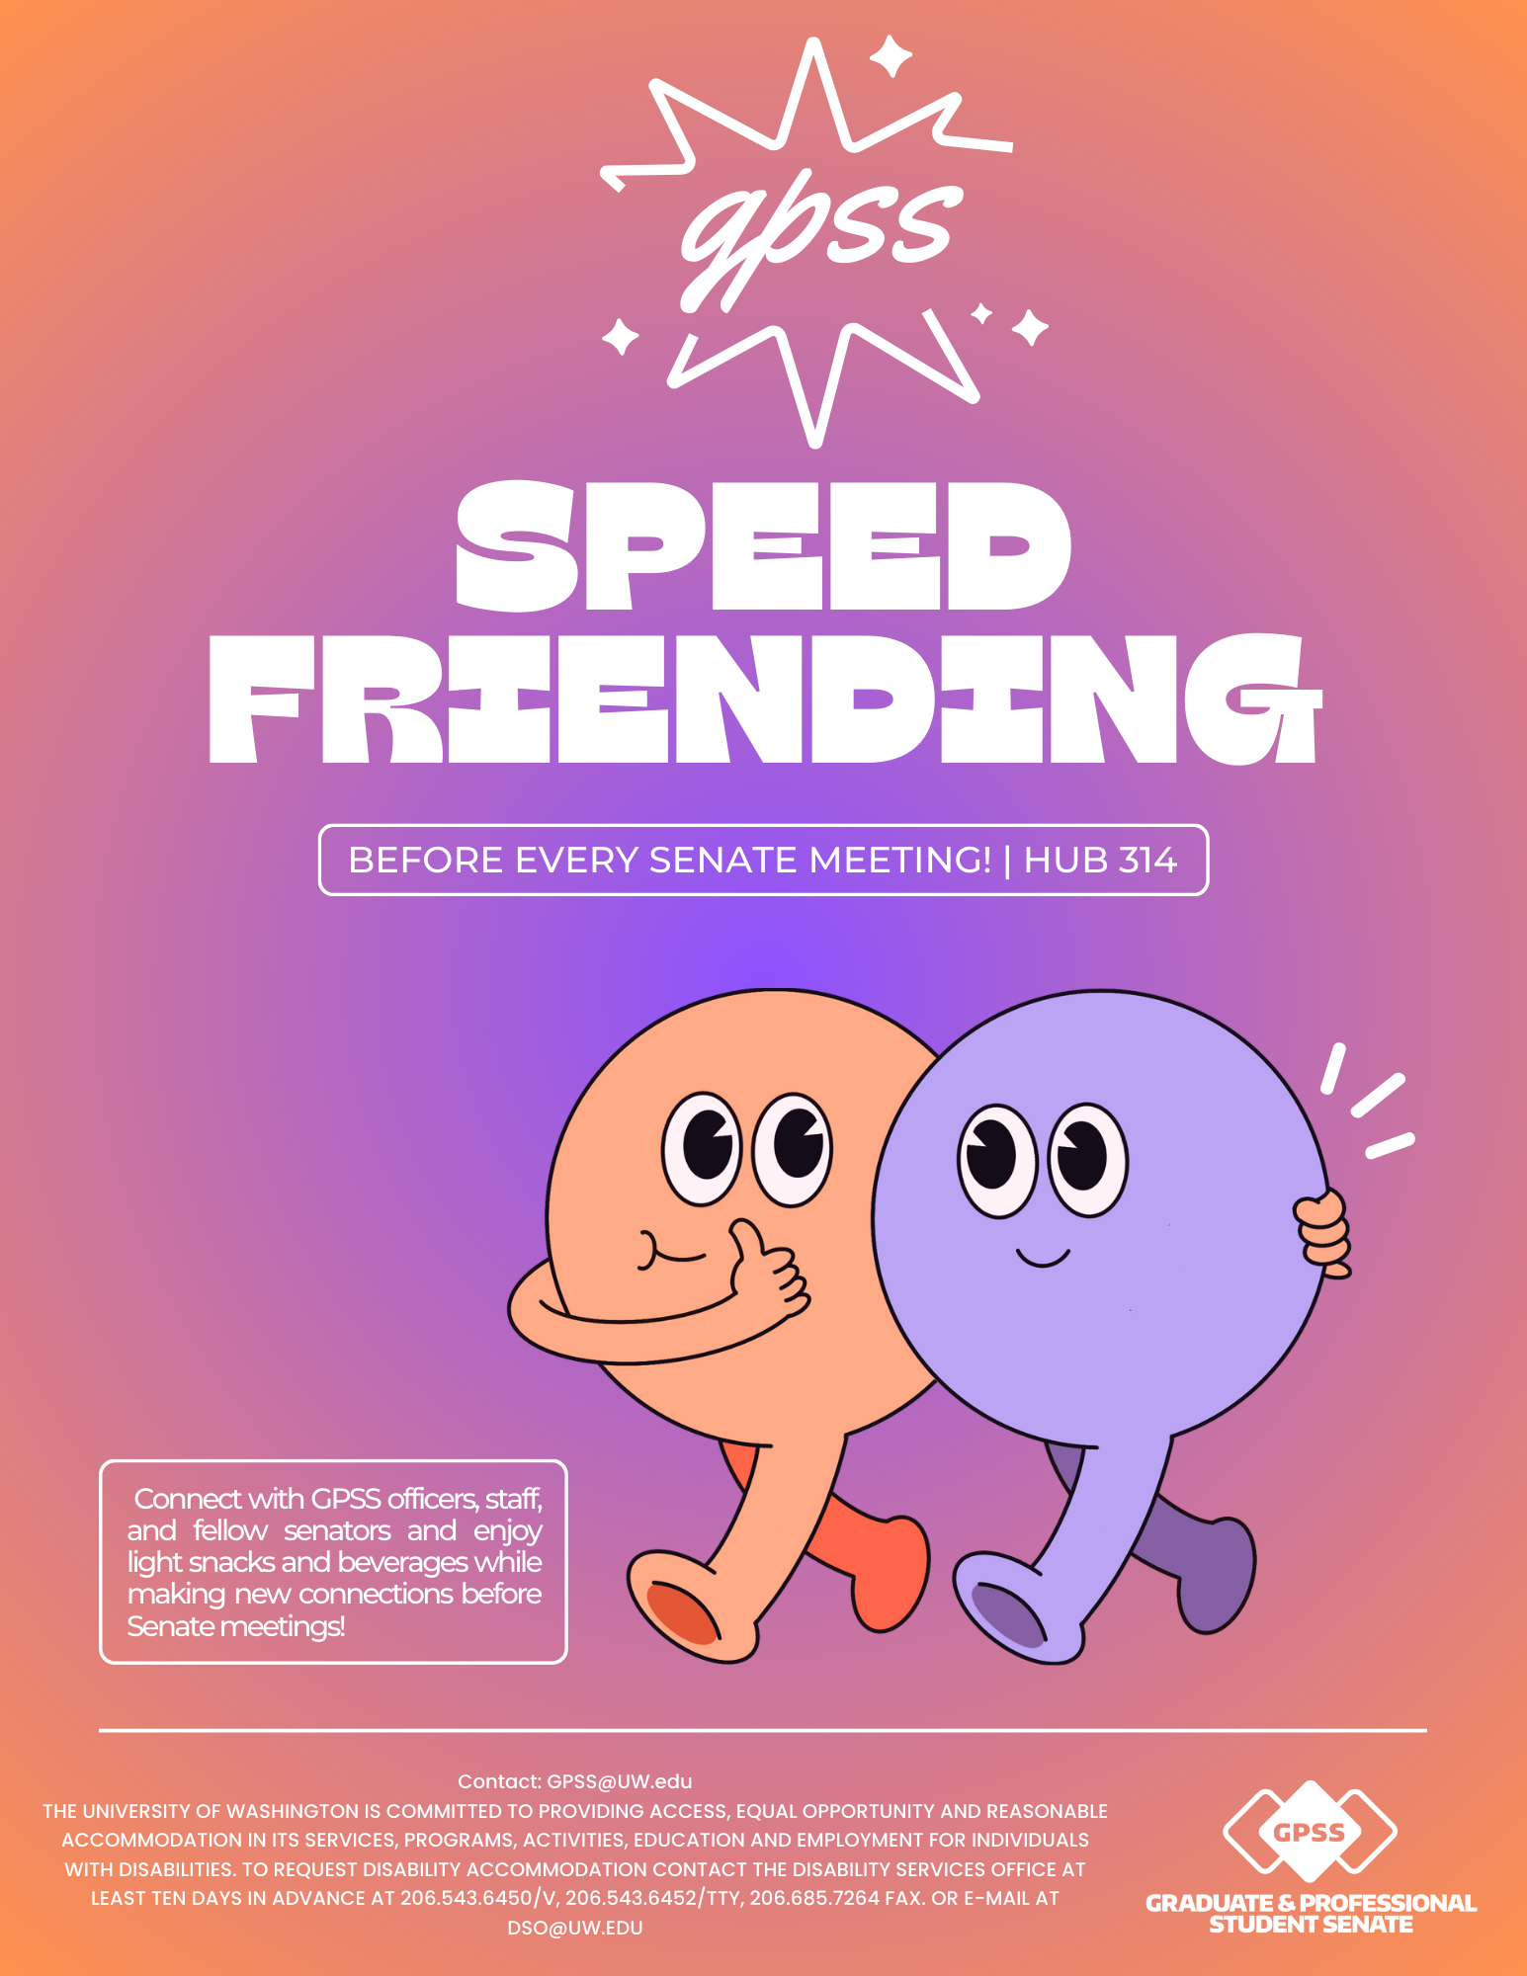
What: A fun, casual event to meet and connect with other graduate and professional students
When: Next meeting on December 4, from 4:00 to 5:00 p.m.
Where: HUB 314
Why Join:
Make new friends across different graduate programs
Expand your network in a friendly, welcoming environment
Enjoy engaging conversations and community-building
Who: Open to all graduate and professional students at UW

Slide 12
GPSS Weekly Coffee Chats
Wednesdays
12:00 – 5:00 PM
Pop-by before senate and chat with officers/staff or grab some free coffee!
Q&A on Senator Handbook and Parliamentary Procedure is welcomed!
Notes:
kana

Slide 13
21+ Students only with valid ID (Senators only)
Drinks, snacks and crafts will be provided!
Email Noah at gpssvpadmin@uw.edu for more information!

Slide 14
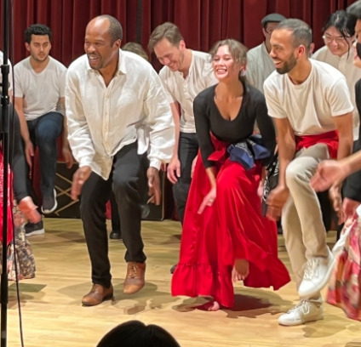
Arts Council Get Together
Ethnomusicology Visiting Artist Concert: Miguel Ballumbrosio, Afro-Peruvian Music and Dance
Tuesday, December 3, 2024 - 7:30pm
Brechemin Auditorium
FREE
More information, contact Noah at gpssvpadmin@uw.edu

Slide 15
GPSS Website Survey
Help us create a better web experience for GPSS
More information: Contact Vidya at gpsswebhelp@uw.edu
https://forms.office.com/r/QiHF7GcTqf

Slide 16
Mandala Arts Workshop
Monday, December 2, 2024
4:00 PM – 5:00 PM
HUB 314
More information: Contact Vidya at gpsswebhelp@uw.edu

Slide 17
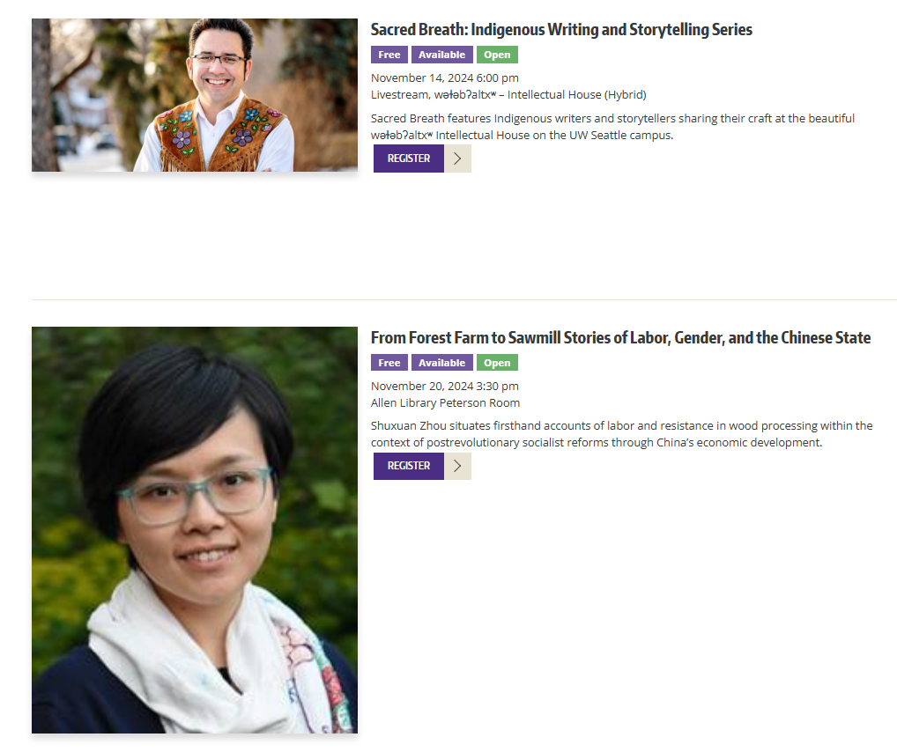
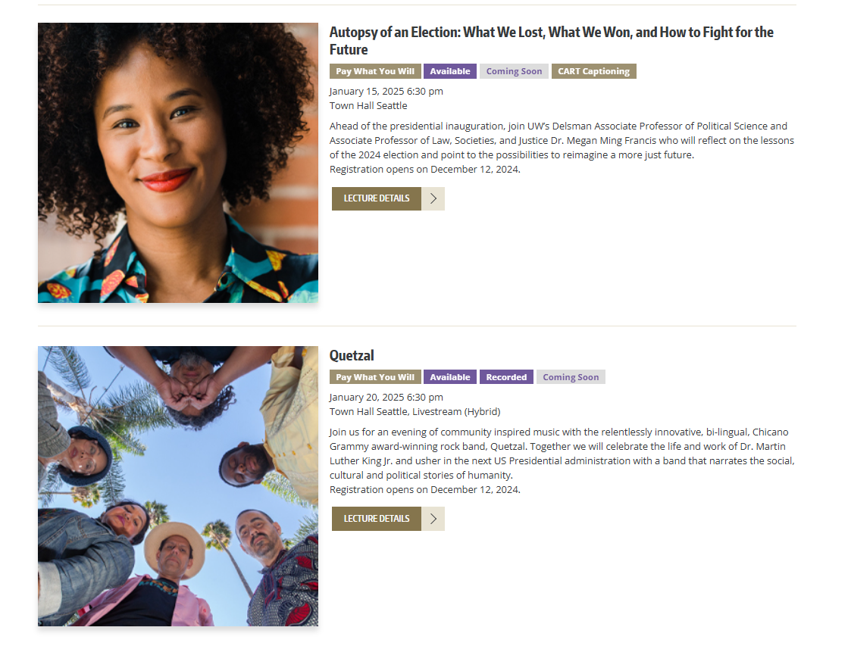
UW Public Lectures
https://www.washington.edu/lectures/
Notes:
Noah

Slide 18
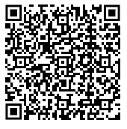
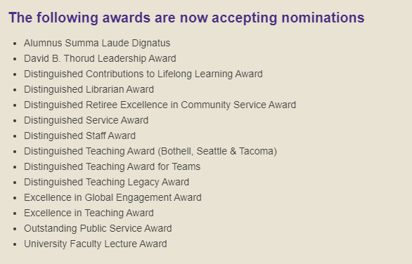
2025 Awards of Excellence
For more than 50 years, the UW’s Awards of Excellence have celebrated outstanding faculty, staff, students and alumni whose achievements exemplify the University’s mission. Make an impact by submitting a nomination today.

Slide 19
The Q Center is excited to share an upcoming social and community building event for LGBTQ+ graduate students!
There will be snacks, art supplies, and low-stress vibes to meet + connect with your graduate student peers!

Slide 20
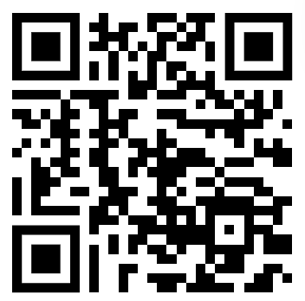
GPSS Senator Survey
https://forms.office.com/r/YLwED38MCZ
Your feedback is invaluable in shaping our plans, addressing any challenges, and making improvements to better serve you and our community.

Slide 21
GPSS Football Night UCLA v. UW
Friday,
November 15th
^{6:00 PM - 9:00 PM}
GPSS Official Pregame – 4:00 PM – 6:00 PM
Free Pizza & Drinks (21+) Provided
Tickets - $38.65 (including taxes/fees)
Notes:
kana

Slide 22
GPSS Winter Hot Chocolate Social
Wednesday,
December 4th
^{1:00 PM - 4:00 PM}
^{Polar Express Movie Showing}
^{Hot Chocolate & Marshmallows}
^{& Care Packages}
Notes:
kana

Slide 23
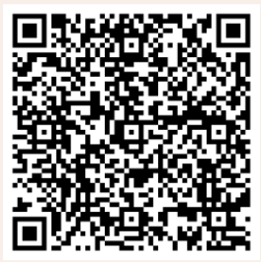
GPSS Winter Formal
Saturday,
December 7th
^{7:00 PM - 10:00 PM}
^{Vista Café}
Music, Food, Drinks & Photobooth! Come out for an evening of dressing up and celebrate the end of the quarter.
RSVP: https://forms.office.com/Pages/ResponsePage.aspx?id=W9229i_wGkSZoBYqxQYL0gmYRYzJbSNFkus_YyDoQa5URVpYUjlMMjM4SExUNFdYNzlNWTdPNU5XQy4u
Notes:
kana

Slide 24
Follow us on Instagram
Join GPSS Senator Group on Teams
Notes:
kana

Slide 25
GPSS Senator DEI Workshop
Wednesday,
November 20th
^{12:00PM- 1:30PM}
Lunch (Banh Mi) will be provided!
Notes:
Edith
Fun icebreakers and activities where we will get to know each other!
Learn about DEI as a whole, within UW, and why it's important to GPSS.
You will also gain skills and resources that you can take back to your departments AND free FOOD! Register so othere is enough food

Slide 26
Student Technology Fee (STF)
5 min

Slide 27
Joy Williamson-Lott, the Dean UW Graduate School
15 min

Slide 28
Resolution Honoring the Legacy of Governor Daniel J. Evans
10 min
Notes:
Emilio Castaneda, Mykhail Lembke

Slide 29
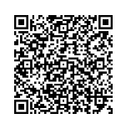
Resolution Honoring the Legacy of Governor Daniel J. Evans You may review the Resolution using this link (log in with UW account)
GPSS_Resolution_Honoring_Governor_Evans.docx

Slide 30
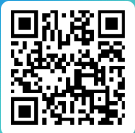
Motion to Suspend the Rules
Because this resolution is time-sensitive, this motion will allow to move to a second/third reading so that the Senate can vote on the Resolution at this meeting.
https://forms.office.com/r/1WiYXw82ar

Slide 31
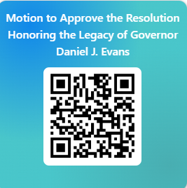
Resolution Honoring the Legacy of Governor Daniel J. Evans Please vote using this form (log in with UW account)
https://forms.office.com/r/uuhvC5KRR6

Slide 32
Legislative Agenda
15 min

Slide 33
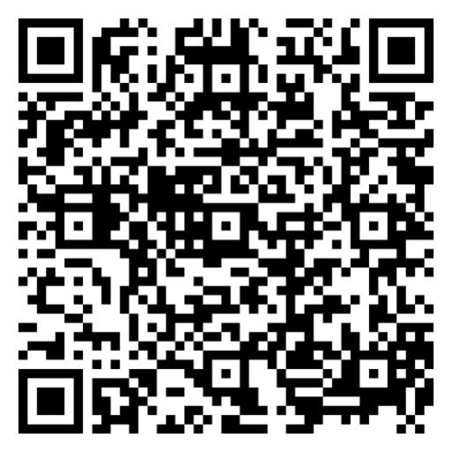
Legislative Agenda
You may review the GPSS Legislative Agenda 2025 using this link
(log in with UW account) 2024-2025 Legislative Agenda.docx

Slide 34
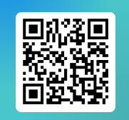
Motion to Approve the 2025 Legislative Agenda Proposal
Please vote using this form (log in with UW account) https://forms.office.com/r/BaQd37w2Mc

Slide 35
Senator of the Month
5 min
Notes:
Senator of the month is recognition that we give out to senators that have made meaningful contributions to the senate space. The executive committee makes recommendations and selections for this recognition. For the month of October, the executive senate recognizes Marina Zub.

Slide 36
Congratulations, Marina!
Thank you for your engagement!

Slide 37
Election and Judicial Committee Formation
15 min
Notes:
Beth

Slide 38
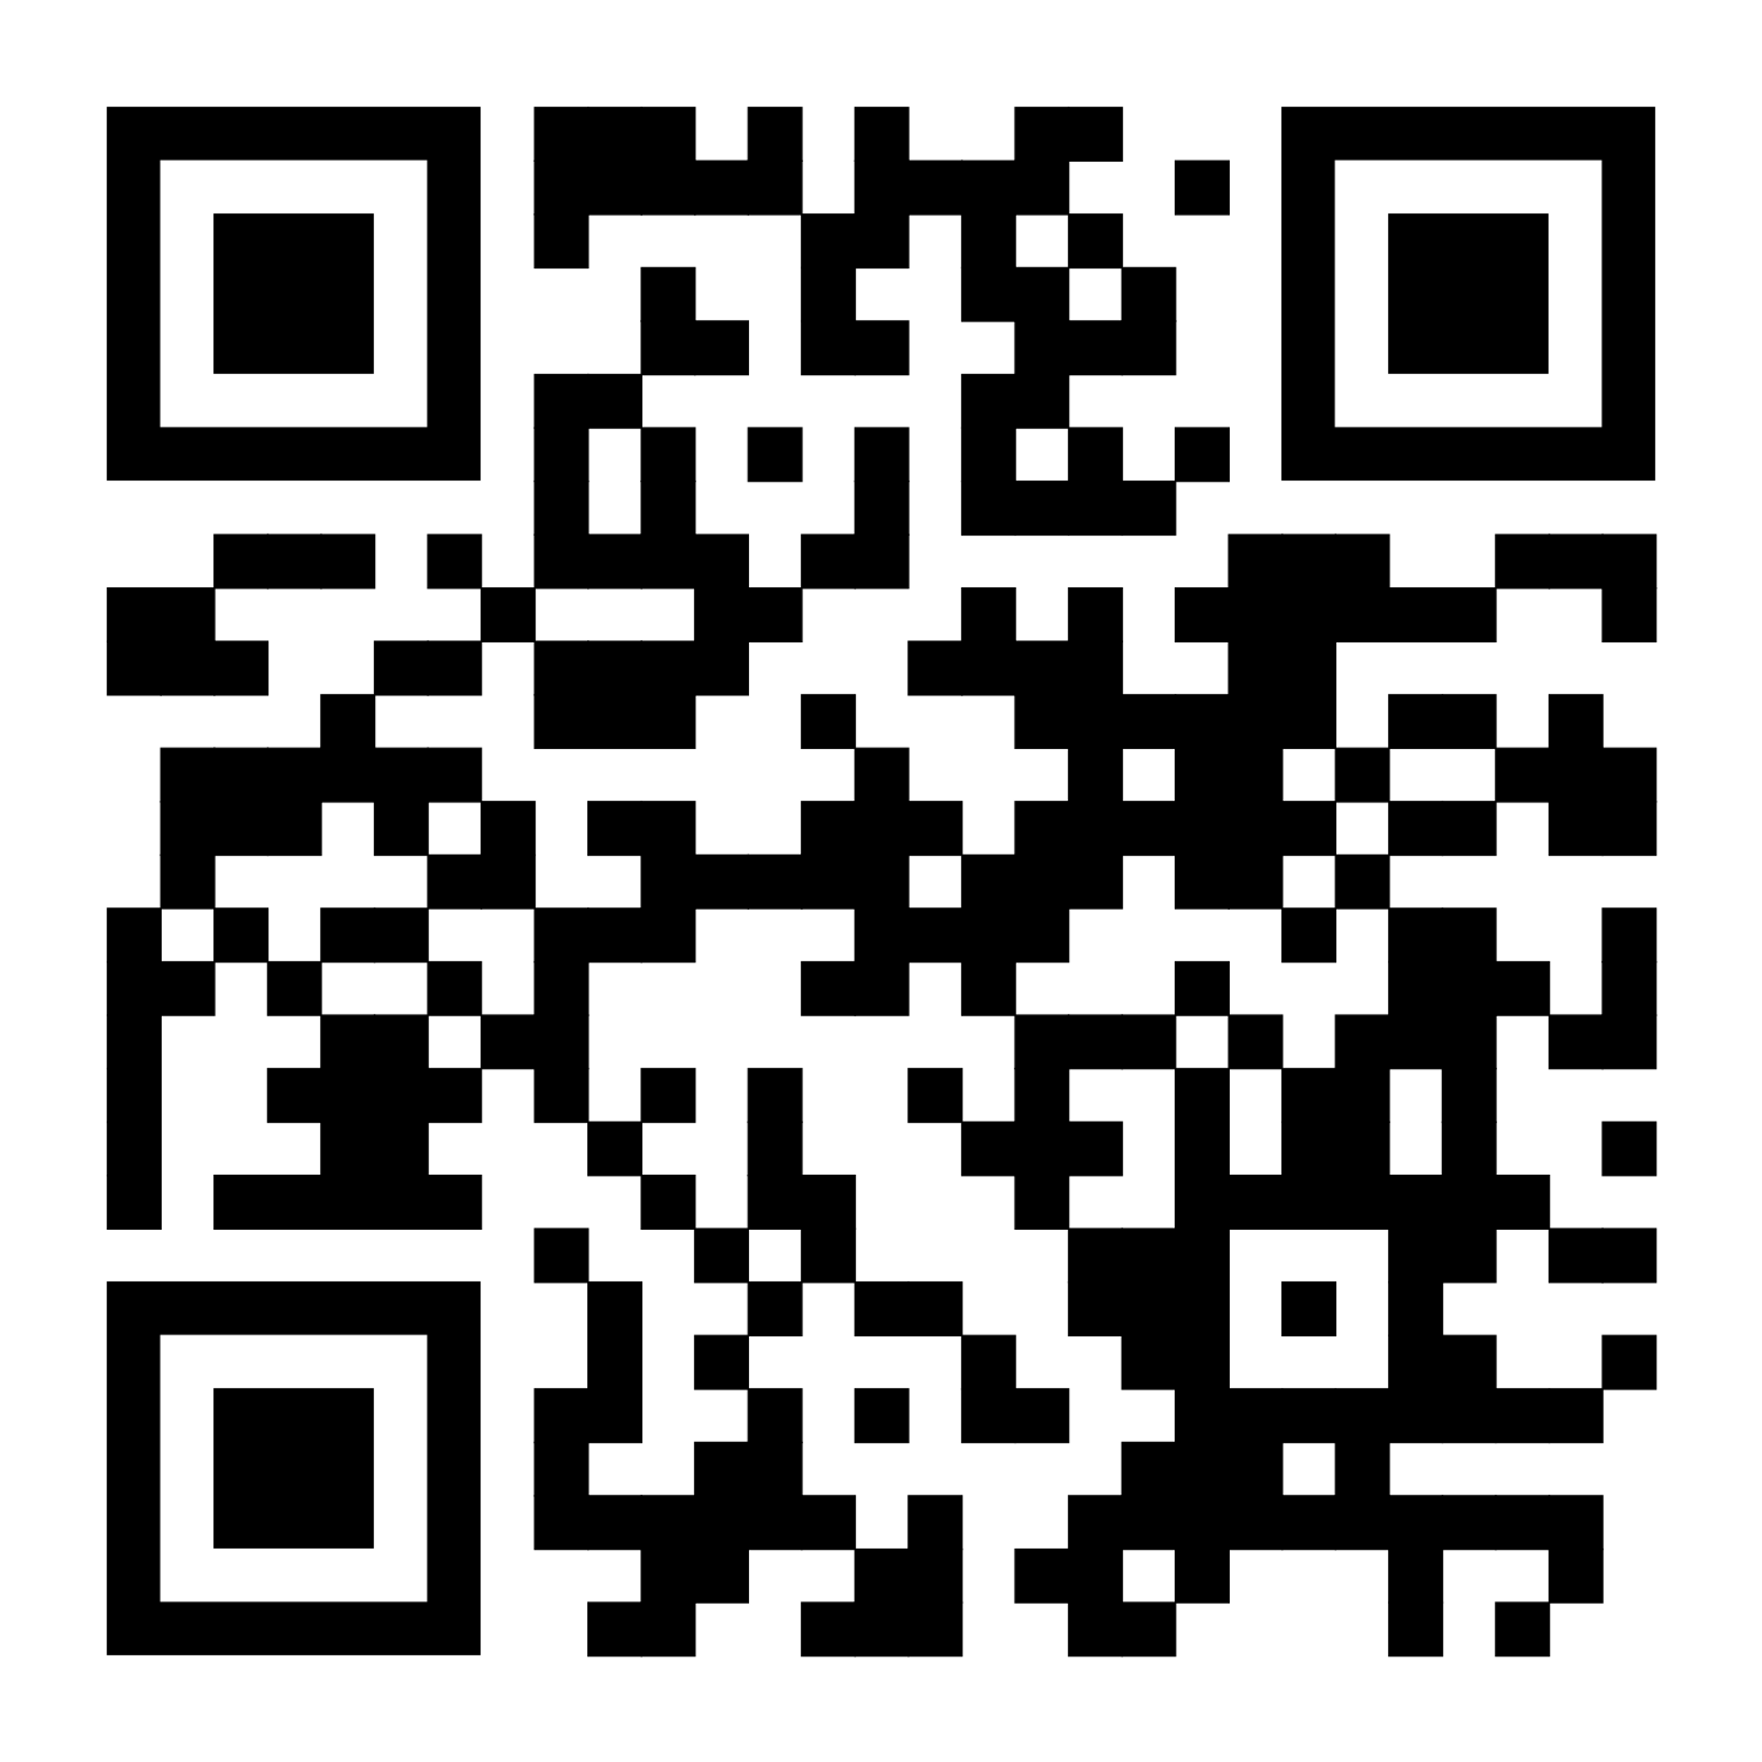
Judicial Committee
Composition:
The VP of Equity and Inclusion (non-voting) and up to six Senators.
Judicial Committee members cannot serve on other GPSS internal committees, run for GPSS office, or remain on the Committee if they choose to run for office
Functions:
GPSS's investigative body
Addressing grievances related to the GPSS Constitution, Bylaws, procedures, committees, Officers, Officer candidates, or Senators.
It also reviews proposed Bylaw changes before they are presented to the GPSS.
Only for currently registered Senators

Slide 39
Elections Committee
Composition:
At least 4 at-large Senators in good standing
1 Executive Senator
Elections Committee members cannot be current GPSS Officers or candidates; must resign 35 days before Officer Elections if running
Functions:
Ensure fair, transparent, and inclusive GPSS elections per Bylaws and Constitution
Adopt Elections Rules and create an Elections Guide
Conduct elections and enforce rules, including terminating candidacies for violations
Only for currently registered Senators
Tuesdays from
1-2PM in the GPSS Office (HUB 314) and on zoom

Slide 40
Committees Recruitment

Slide 41
Finance & Budget Committee
Composition:
GPSS VP of Finance
Director of Student Activities and Union Facilities (or designee)
5-9 elected Senators (appointed by the President, approved by the Executive Committee)
Functions:
Manage allocation of GPSS Grant Budget from Finance and Budget Committee
Advertise, review, and approve special/departmental requests (with exceptions)
Review and recommend annual budget for the next fiscal year
Follow and revise the “Special and Departmental Allocation Funding Packet”
Only for currently registered Senators
Notes:
ryan

Slide 42
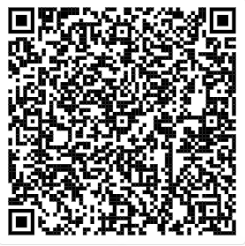
Travel Grants Committee
Functions
Assist the Treasurer in communicating policies and procedures governing the Travel Grants process
Assist the Treasurer in advertising the availability of Travel Grants to the GPSS Senators and other graduate and professional students
Review and recommend an annual Travel Grants budget to the Finance and Budget Committee for the following fiscal year.
Open to everyone!
Meetings Tuesdays, 7:00 PM – 8:00 PM, on Zoom

Slide 43
Legislative Advisory Board
Functions
Assists the Vice President of External Affairs in developing a legislative agenda for Winter Quarter’s legislative session
Advise and assist the Vice President of External Affairs on issues related to the GPSS’s lobbying efforts and in particular Graduate Student on Day on the Hill (Huskies on the Hill)
Assist with lobbying during the interim Spring, Summer, and Fall quarters
Open to everyone!
Mondays, 3:00 PM to 4:00PM in HUB 303

Slide 44
Diversity Committee
Open to everyone!
Functions:
Address historical inequities in academic structures
Establish criteria and award GPSS Diversity Funds grants
Conduct annual GPSS Composition Surveys
Plan and promote campus-wide diversity events
Collaborate on diversity programming with students, faculty, and staff
Facilitate communication on diversity issues within departments
Hear grievances related to inequities (e.g., racism, sexism, homophobia) and refer to the Judicial Committee if necessary
Meetings: Bi-weekly on Fridays at 1:00PM

Slide 45
Science & Policy Committee
What do we do?
UW's Graduate Research Symposium
2025 NSPN Symposium
Held in Seattle in May
Policy Writing
E.g.: GPSS Resolutions JSPG article, White paper, etc.
Outreach
Science Outreach and Policy for Adults (SOPA)
Professional Development Events
Meet with Legislators
And more!
Meetings
Tuesdays from
1-2PM in the GPSS Office (HUB 314) and on zoom
Notes:
ella

Slide 46
Arts Council
Open to everyone!
Functions
The Arts Council creates a space for students in the arts across campus to collaborate interdisciplinarily, develop a stronger community, and advocate for the improvement of issues recognized during Council meetings that affect students within the arts at UW.
Book Club
Knitting & Crochet Circle
Events
Meetings: Mondays, 4:00 PM – 5:00 PM, HUB 314
Notes:
noah

Slide 47
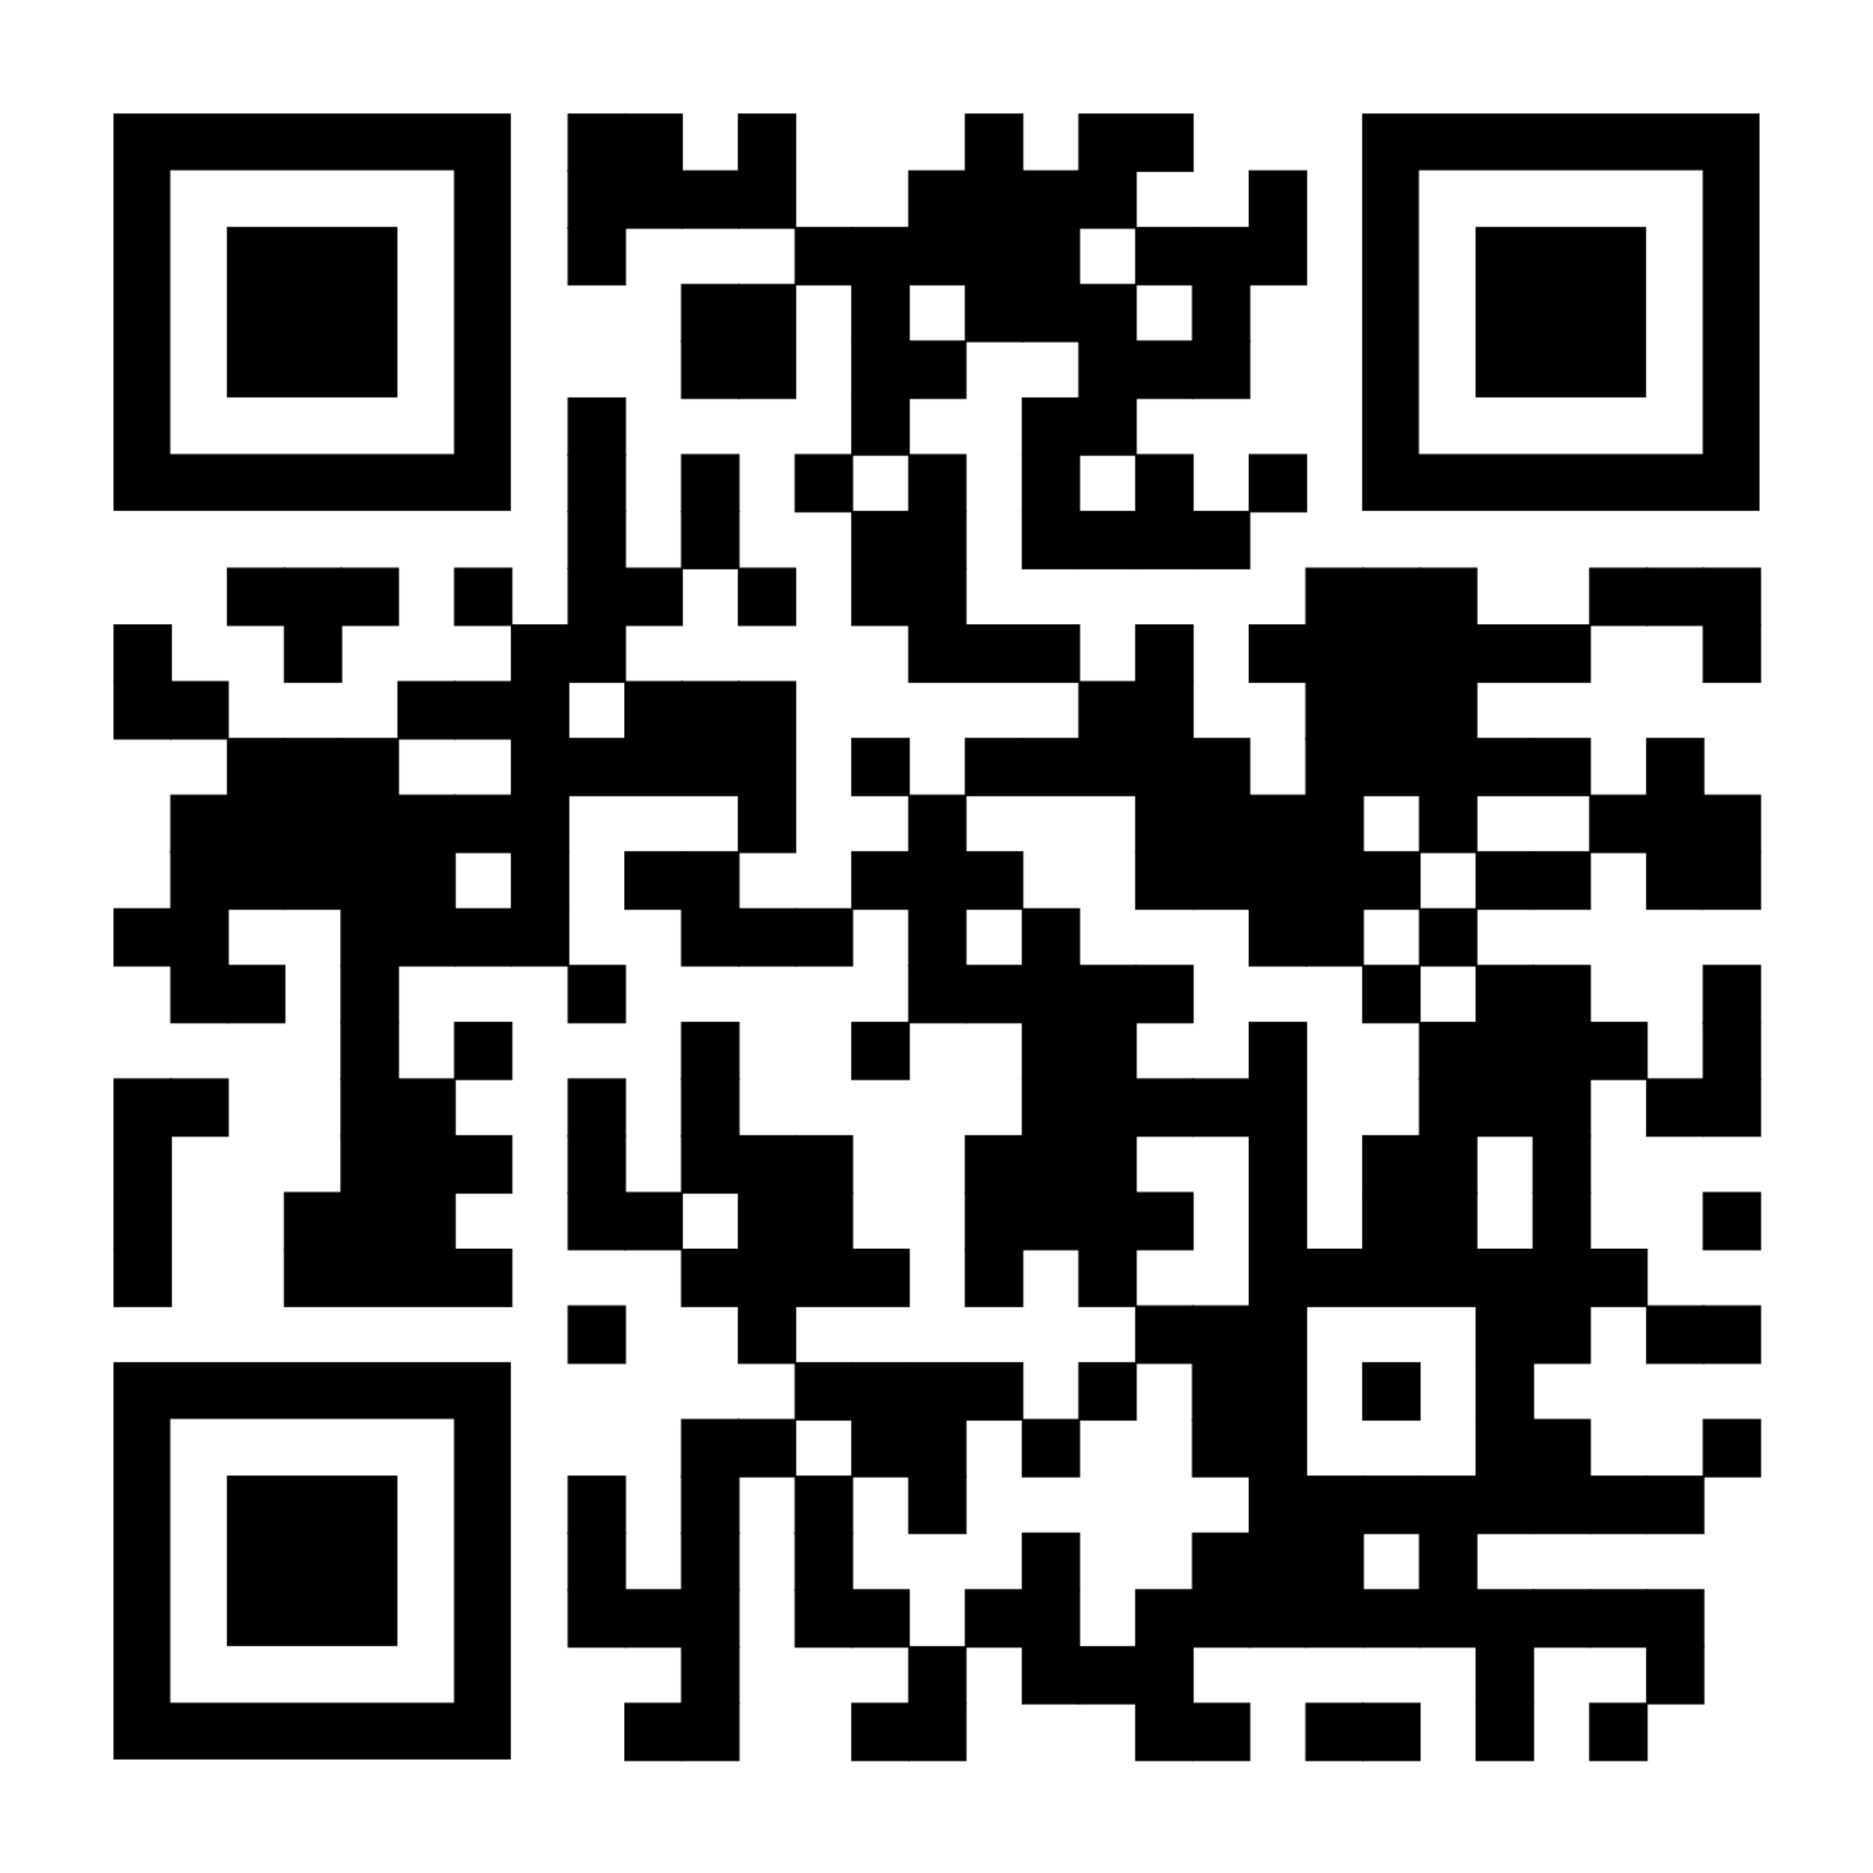
Sustained Dialogue
A Method of Conflict Resolution Through Diplomacy and Openness
Focuses on resolving conflicts through diplomacy and openness to opposing views. Encourages constructive dialogue rather than debate.
Goal of UW Chapter:
Host regular dialogue facilitation sessions on topics of interest.
Start with GPSS members and expand to the broader student body.
For more information or to participate, contact:
Clare Koesters: ckoest@uw.edu
Beth Fawcett: eafawc@uw.edu
Noah Hough: gpssvpadmin@uw.edu
Scan for Topic Survey!
Open to everyone!
Next meeting:
Wednesday, December 4
4:00 PM – 5:00 PM
HUB 314

Slide 48
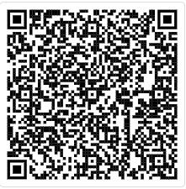
Committee of Senator Motivation and Retention (CSMR)
Functions
Research and identify resources that support both senators and graduate students.
Develop informational materials to assist international and out-of-state students with their transition to UW.
Point of Contact: Noah Hough at gpssvpadmin@uw.edu
Open to everyone!
Meetings weekly on Fridays from 12:00 PM to 1:00 PM during this quarter.

Slide 49
Executive Senator Positions
10 min
Notes:
noah

Slide 50
Executive Senator Responsibilities: - Attend all regular GPSS Meetings (3-5 per quarter) - Attend Executive Committee Meetings (3-5 per quarter, including summers) - Choose your own adventure for getting more involved in GPSS—Chair a GPSS committee, form an ad hoc committee, sponsor and/or author resolutions, volunteer to assist with events, serve as an appointee on a University committee, etc. Executive Senators terms are two (2) years or until graduation, whichever comes first. They act as a crucial form of checks and balances, representing the Senate itself on the Executive Committee. They receive monetary recognition for their extra time commitments and responsibilities in the amount of $450 per quarter (Fall, Winter, and Spring), disbursed at the end of the Academic year.
There are two (2) Executive Senator Positions open!
Notes:
noah

Slide 51
Candidates may be nominated of self-nominated in advance to the VP of Administration (gpssvpadmin@uw.edu) via email, or they may be (self-)nominated in person, "from the floor" of the Senate during the election meeting. Each candidate will be given exactly three (3) minutes to speak to their interests in and qualifications for the positions at the election.
Executive Senator Elections
Notes:
noah

Slide 52
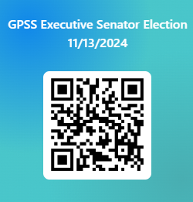
GPSS Executive Senator Election Voting
Vote at this link:
https://forms.office.com/r/6qyvnYu5Lq
Notes:
noah

Slide 53
Adjournment
1 min
Notes:
richard

Slide 54
Follow us on Instagram
Join GPSS Senator Group on Teams
Notes:
kana

