Slide 1
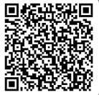
UNIVERSITY OF WASHINGTON
GRADUATE & PROFESSIONAL
STUDENT SENATE
SafeCampus (206-685-7233)
Call SafeCampus anytime to anonymously discuss safety and well-being concerns for yourself or others.
https://www.washington.edu/safecampus/
Childcare Assistance Program
https://www.washington.edu/financialaid/types-of-aid/child-care-assistance/
UW Food Pantry
https://www.washington.edu/anyhungryhusky/the-uw-food-pantry/
Student Technology Loan Program
The Student Technology Loan Program (STLP) is a free, student-led program that supports the academic technology needs of UW Seattle students
https://stlp.uw.edu/
Attendance Form
(Word of the Day: Honorificabilitudinitatibus)
Attendance Form Link:
https://forms.office.com/r/2L3QKrPRXc

Slide 2
Call To Order
1 min
Notes:
remind the Senate that all votes will be public. Zoom attendees should privately message VP of Admin with questions. Mention that there will be CART captioning for the meeting

Slide 3
1. Call to Order (Sponsor: Richard Schure, Time: 1 min.) [ACTION] 2. Land Acknowledgement (Sponsor: Edith Dale Time: 2 min.) [INFORMATION]
3. Announcements/ Public Comments (Sponsor: Richard Schure, Time: 10 min.) [INFORMATION]
4. Approval of Agenda (Sponsor: Richard Schure, Time: 1 min.) [ACTION]
5. Approval of Minutes (Sponsor: Richard Schure, Time: 1 min.) [ACTION]
6. Motion to Retroactively Validate All Action Items in Senate Meeting on February 19, 2025 by Mutual Consensus (Sponsor: Noah Hough, Time: 1 min.) [ACTION]
7. Student Health Fee Survey (Sponsor: Mykhail Lembke, Time: 10 min.) [ACTION]
8. Resolution For the Expansion of Class Accessibility (Second/Third Reading) (Sponsor: Autumn Yi, Time: 25 min) [ACTION]
9. Resolution for Compliance with DEI and Non-discrimination Policies by the Jackson School of Interational Studies (First Reading) (Sponsor: Ryan Wicklund, Pavandeep Josan, Time: 5 min) [INFORMATION]
10. A Joint Resolution Between GPSS and ASUW to Address Allegations of Sexism Within the University of Washington’s Institutions (First Reading) (Sponsor: Ryan Wicklund, Time: 5 min) [INFORMATION] 11. Resolution for the Graduate and Professional Student Senate (GPSS) to Join the United States Students Association (USSA) (First/ Second/ Third Reading) (Sponsor: Mykhail Lembke, Ryan Wicklund, Time: 25 min) [ACTION]
12. Resolution on King County Metro Bus Driver Shawn Yim and Honoring Transit Appreciation Week (First/ Second/ Third Reading) (Sponsor: Emilio Castañeda, Francis Choe, Time: 25 min) [INFORMATION]
13. Resolution for the Graduate and Professional Student Senate to Oppose Senate Bill 5785 and Support House Bill 1839 (First/ Second/ Third Reading) (Sponsor: Mykhail Lembke, Ryan Wicklund, Time: 25 min) [ACTION]
14. Senator of the Month (Sponsor: Edith Dale, Time: 5 min) [INFORMATION]
15. Officer Updates (Sponsor: Richard Shure, Time: 30 min) [INFORMATION]
16. Adjournment (Sponsor: Richard Schure, Time: 1 min.) [ACTION]
Approval of Agenda
1 min
Total Time: 184 minutes
Anticipated End Time: 8:30 PM
Attendance Form Link:
https://forms.office.com/r/2L3QKrPRXc

Slide 4
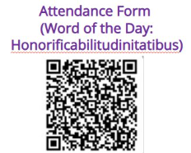
Minutes from the GPSS Meeting 02/19, as circulated by email by Senate Director Annika Peterson on 3/11.
Approval of Minutes
1 min

Slide 5
Land Acknowledgement
2 min
Notes:
Edith - Every community owes its existence and vitality to generations from around the world who contributed to making the history that led to this moment. Indigenous People have lived here continuously since time immemorial, and Seattle is now a highly cosmopolitan territory with overlapping sovereignties and fidelities. Acknowledging the land we are on is only the first step. Therefore the Graduate and Professional Student Senate at the University of Washington in Seattle acknowledges the Coast Salish peoples of this land, the land which touches the shared waters of all tribes and bands within the Suquamish, Tulalip, and Muckleshoot nations and all traditional lands on which we learn and work.

Slide 6
Within UW: - Get involved with LAB and the WSA! GPSS has advocated for a tuition waiver program for Native American students - wǝɫǝbʔaltxʷ - UW Intellectual House - https://www.washington.edu/diversity/intellectual-house/ - ASUW American Indian Student Commission (AISC): http://aisc.asuw.org Community: - Native and Strong Lifeline – 988 (option 4) The Native and Strong Lifeline is the first program of its kind in the nation dedicated to serving American Indian and Alaska Native people. Operated by Volunteers of America Western Washington, this line is available for people who call the 988 Lifeline and choose option 4. It is specifically for Washington’s American Indian and Alaska Native communities. Calls are answered by Native crisis counselors who are tribal members and descendants closely tied to their communities. Native and Strong Lifeline counselors are fully trained in crisis intervention and support, with special emphasis on cultural and traditional practices related to healing. - Stand with the Duwamish: https://www.duwamishtribe.org/stand-with-the-duwamish
Resources for Action
- Real Rent Duwamish: https://www.realrentduwamish.org Other resources:
Find out whose traditional land you live on with this interactive map: https://native-land.ca/
What is the purpose of a land acknowledgement? https://retirees.uw.edu/event/from-recognition-to-action-understanding-land-acknowledgments/
- Article from Patagonia: All Trails Belong to Mother Earth, Following in Indigenous Footsteps on the Ute Pass Trail
Documentary on "The Rights of Nature: A Global Movement"
Notes:
Edith - Washington Student Association

Slide 7
Announcements/ Public Comments
10 min

Slide 8
LiveWell Kits!
LiveWell Kits
LiveWell and ASUW are excited to offer FREE well-being and health kits for UW students. Each kit equips students with resources, information, and supplies tailored to different dimensions of wellness. Limited availability! Orders will be open until supplies run out (or by March 19 at 5 p.m.). Order Now!
https://livewell.uw.edu/kits/
Notes:
EDITH: Sexy time kits: condoms, wipes, tissues, brownies. Paws and relax: Essential oils, teas, affirmation stickers, cards. Party with a plan kit: Naloxone, fentanyl test strips, vitamin C etc

Slide 9
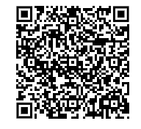
RSVP here:
https://tinyurl.com/VirtualLobby25

Slide 10
Interdisciplinary Graduate Research Symposium
Date: May 28th 2025 from 12:00-4:00 pm
Location: HUB Ballroom (2nd Floor)
Notes:
Claire

Slide 11
Paint & Sip!
April 4th 6-8PM in HUB 314
Notes:
Edith

Slide 12
Cultural Showcase
April 10th 12-2PM at Intellectual House
Notes:
Edith

Slide 13
Nutrition Workshop
Friday 4/18
3-4 PM
HUB 214

Slide 14
GPSS Karaoke Night
Friday 4/25
5-7 PM
HUB 314

Slide 15
Check website or contact chairs for Spring quarter committee meeting times!

Slide 16
Student Health Fee Survey
10 min
Notes:
richard

Slide 17
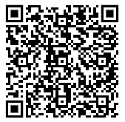
Student Health Fee Survey
Please view the survey here:
Student Health Fee Survey

Slide 18
Motion to Retroactively Validate All Action Items in Senate Meeting on February 19, 2025 by Mutual Consensus
1 min
Notes:
richard

Slide 19
Resolution For the Expansion of Class Accessibility
25 min
Notes:
richard

Slide 20
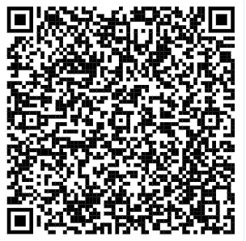
Resolution For the Expansion of Class Accessibility
You may review the Resolution using this link (Log in with UW account)
Resolution for the Expansion of Class Accessibility.docx

Slide 21
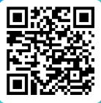
Resolution For the Expansion of Class Accessibility
Please vote using this form (log in with UW account)
https://forms.office.com/r/n2FmsA285x

Slide 22
Resolution for Compliance with DEI and Non-discrimination Policies by the Jackson School of International Studies
5 min
Notes:
richard

Slide 23
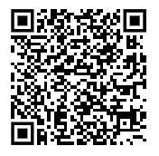
Resolution for Compliance with DEI and Non-discrimination Policies by the Jackson School of Intenational Studies
You may review the Resolution using this link (Log in with UW account)
Resolution on Compliance with DEI and Non-Discrimination.docx

Slide 24
A Joint Resolution Between GPSS and ASUW to Address Allegations of Sexism Within the University of Washington’s Institutions
5 min
Notes:
richard

Slide 25
Equity Resource Guide and Toolkit
Sexual Assault Resources
UW Well Being
UW Live Well
Notes:
richard

Slide 26
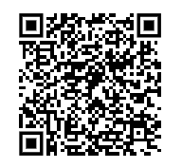
A Joint Resolution Between GPSS and ASUW to Address Allegations of Sexism Within the University of Washington’s Institutions
You may review the Resolution using this link (Log in with UW account)
A Joint Resolution to Address Allegations of Sexism and the Fostering of a Hostile Work Environment Affecting UW Students and Faculty.docx

Slide 27
Motion to Suspend the Rules
Notes:
richard

Slide 28
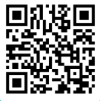
Motion to Suspend the Rules
25 min
Please vote using this form (log in with UW account)
https://forms.office.com/r/my3kV4WVgy
Notes:
richard

Slide 29
Resolution for the Graduate and Professional Student Senate (GPSS) to Join the United States Students Association (USSA)
25 min
Notes:
richard

Slide 30
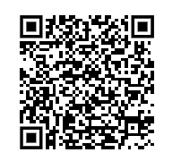
Resolution for the Graduate and Professional Student Senate (GPSS) to Join the United States Students Association (USSA)
You may review the Resolution using this link (Log in with UW account)
Resolution For The Graduate And Professional Student Senate (GPSS) To Join The United States Student Association (USSA).docx

Slide 31
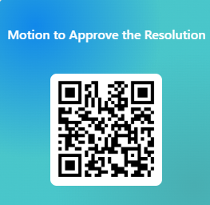
Resolution for the Graduate and Professional Student Senate (GPSS) to Join the United States Students Association (USSA)
Please vote using this form (log in with UW account)
https://forms.office.com/r/dAr8Jj1NDP

Slide 32
Resolution on King County Metro Bus Driver Shawn Yim and Honoring Transit Appreciation Week
25 min
Notes:
richard

Slide 33
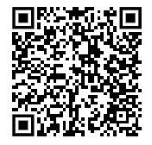
Resolution on King County Metro Bus Driver Shawn Yim and Honoring Transit Appreciation Week
You may review the Resolution using this link (Log in with UW account)
Resolution On King County Metro Bus Driver Shawn Yim And Honoring Transit Appreciation Week.docx

Slide 34
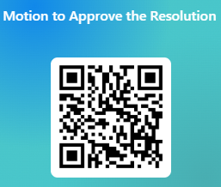
Resolution on King County Metro Bus Driver Shawn Yim and Honoring Transit Appreciation Week
Please vote using this form (log in with UW account)
https://forms.office.com/r/USQvdgUZZ0

Slide 35
Resolution for the Graduate and Professional Student Senate to Oppose Senate Bill 5785 and Support House Bill 1839
25 min
Notes:
richard

Slide 36
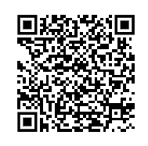
Resolution for the Graduate and Professional Student Senate to Oppose Senate Bill 5785 and Support House Bill 1839
You may review the Resolution using this link (Log in with UW account)
Resolution for the Graduate and Professional Student Senate to Oppose Senate Bill 5785 and Support House Bill 1839

Slide 37
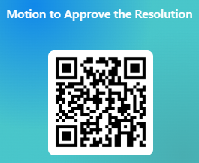
Resolution for the Graduate and Professional Student Senate to Oppose Senate Bill 5785 and Support House Bill 1839
Please vote using this form (log in with UW account)
https://forms.office.com/r/pnjr3Cqxie

Slide 38
Senator of the Month
5 min
Notes:
richard

Slide 39
Congratulations, Emilio!
Thank you for your great work and dedication to GPSS!

Slide 40
Officer Updates
30 min
Notes:
richard

Slide 41
Adjournment
1 min
Notes:
richard

Slide 42
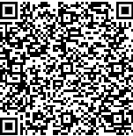
Follow us on Instagram :)
Join GPSS Senator Group on Teams

