Slide 1
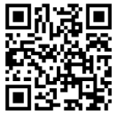
UNIVERSITY OF WASHINGTON
GRADUATE & PROFESSIONAL
STUDENT SENATE
SafeCampus (206-685-7233)
Call SafeCampus anytime to anonymously discuss safety and well-being concerns for yourself or others.
https://www.washington.edu/safecampus/
Childcare Assistance Program
https://www.washington.edu/financialaid/types-of-aid/child-care-assistance/
UW Food Pantry
https://www.washington.edu/anyhungryhusky/the-uw-food-pantry/
Student Technology Loan Program
The Student Technology Loan Program (STLP) is a free, student-led program that supports the academic technology needs of UW Seattle students
https://stlp.uw.edu/
Attendance Form
(Word of the Day: Anencephalous)
Attendance Form Link:
https://forms.office.com/r/0H2uAp9dkS

Slide 2
Call To Order
1 min
Notes:
remind the Senate that all votes will be public. Zoom attendees should privately message VP of Admin with questions. Mention that there will be CART captioning for the meeting

Slide 3
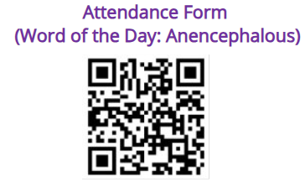
1. Call to Order (Sponsor: Richard Schure, Time: 1 min.) [ACTION]
2. Approval of Agenda (Sponsor: Richard Schure, Time: 1 min.) [ACTION]
3. Approval of Minutes (Sponsor: Richard Schure, Time: 1 min.) [ACTION]
4. Land Acknowledgement (Sponsor: Edith Dale Time: 2 min.) [INFORMATION]
5. Announcements/ Public Comments (Sponsor: Richard Schure, Time: 10 min.) [INFORMATION]
6. Student Regent (Sponsor: Richard Schure, Time: 10 min.) [INFORMATION]
7. GPSS AY25-26 Election Meeting (Sponsor: Alec Solemslie, Time: 5 min.)
8. GPSS Composition Survey (Sponsor: Noah Hough, Time: 5 min.) [INFORMATION]
9. U-PASS (Sponsor: Richard Schure, Time: 10 min.) [ACTION]
10. Student Technology Fee (Sponsor: Richard Schure, Time: 5 min.) [INFORMATION]
11. Resolution For the Expansion of Class Accessibility (Third Reading) (Sponsor: Ryan Wicklund, Autumn Yi, Time: 20 min) [ACTION]
12. Resolution to Improve Accessibility in the Dorms (First Reading) (Sponsor: Ryan Wicklund, Autumn Yi, Time: 10min) [INFORMATION]
13. Resolution for Compliance with DEI and Non-discrimination Policies by the Jackson School of International Studies (Second/ Third Reading) (Sponsor: Ryan Wicklund, Time: 25 min) [ACTION]
14. Resolution in Support of Degree Completion Pathways for Students Affected by Visa Revocation (First/ Second/ Third Reading) (Sponsor: Edith Dale, Richard Schure, Ryan Wicklund, Mykhail Lembke, Autumn Yi, Héctor Delgado Díaz, Time: 10 min) [ACTION]
15. A Joint Resolution Between GPSS and ASUW to Address Allegations of Sexism Within the University of Washington’s Institutions (Second/ Third Reading) (Sponsor: Ryan Wicklund, Time: 25 min) [ACTION] 16. Resolution on Availability of Sharps Disposal Boxes on Campus (First Reading) (Sponsor: Mykhail Lembke, Richard Schure, Ryan Wicklund, Edith Dale, Time: 5 min) [INFORMATION]
17. Resolution in Calling on University Administrators to Speak Out About Federal Funding Cuts and Overreach (First Reading) (Sponsor: Ella Spurlock, Time: 5 min) [INFORMATION]
18. GPSS FY 2026 Budget Projection (Sponsor: Ryan Wicklund, Time: 20 min) [ACTION]
19. Senator of the Month (Sponsor: Edith Dale, Time: 5 min) [INFORMATION]
20. Officer Updates (Sponsor: Richard Schure, Time: 30 min) [INFORMATION]
21. Adjournment (Sponsor: Richard Schure, Time: 1 min.) [ACTION]
Approval of Agenda
1 min
Total Time: 221 minutes​
Anticipated End Time: 8:45 PM

Slide 4
Minutes from the GPSS Meeting 03/12, as circulated by email by Senate Director Annika Peterson on 4/23.
Approval of Minutes
1 min
Attendance Form Link: ​
https://forms.office.com/r/0H2uAp9dkS

Slide 5
Land Acknowledgement
2 min
Notes:
Edith - Every community owes its existence and vitality to generations from around the world who contributed to making the history that led to this moment. Indigenous People have lived here continuously since time immemorial, and Seattle is now a highly cosmopolitan territory with overlapping sovereignties and fidelities. Acknowledging the land we are on is only the first step. Therefore the Graduate and Professional Student Senate at the University of Washington in Seattle acknowledges the Coast Salish peoples of this land, the land which touches the shared waters of all tribes and bands within the Suquamish, Tulalip, and Muckleshoot nations and all traditional lands on which we learn and work.

Slide 7
Within UW: - Get involved with LAB and the WSA! GPSS has advocated for a tuition waiver program for Native American students - wǝɫǝbʔaltxʷ - UW Intellectual House - https://www.washington.edu/diversity/intellectual-house/ - ASUW American Indian Student Commission (AISC): http://aisc.asuw.org Community: - Native and Strong Lifeline – 988 (option 4) The Native and Strong Lifeline is the first program of its kind in the nation dedicated to serving American Indian and Alaska Native people. Operated by Volunteers of America Western Washington, this line is available for people who call the 988 Lifeline and choose option 4. It is specifically for Washington’s American Indian and Alaska Native communities. Calls are answered by Native crisis counselors who are tribal members and descendants closely tied to their communities. Native and Strong Lifeline counselors are fully trained in crisis intervention and support, with special emphasis on cultural and traditional practices related to healing. - Stand with the Duwamish: https://www.duwamishtribe.org/stand-with-the-duwamish
Resources for Action
- Real Rent Duwamish: https://www.realrentduwamish.org Other resources:
Find out whose traditional land you live on with this interactive map: https://native-land.ca/
What is the purpose of a land acknowledgement? https://retirees.uw.edu/event/from-recognition-to-action-understanding-land-acknowledgments/
- Article from Patagonia: All Trails Belong to Mother Earth, Following in Indigenous Footsteps on the Ute Pass Trail
Documentary on "The Rights of Nature: A Global Movement"
Notes:
Edith - Washington Student Association

Slide 8
Announcements/ Public Comments
10 min

Slide 9
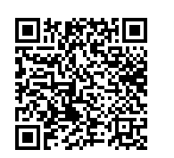
WSA 2025 Spring General Assembly
RSVP
WSA 2025 Spring General Assembly- Issue Proposal Submission

Slide 10
GPSS Karaoke Night
Friday 4/25
5-7 PM
HUB 314

Slide 11
UW GPSS @ Mariners
Sunday 4/27
1:10 PM
T-Mobile

Slide 13
TESTIMONY & TEA TIME!
Tuesday 4/29
5:45-7 PM
HUB 315

Slide 16
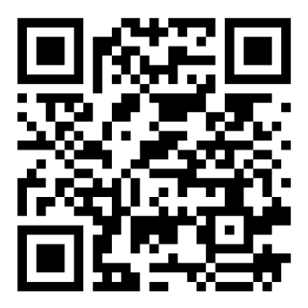
GPSS Drag Show
Date: May 9th 2025, from 6:00-8:00 pm
Location: ECC Theater
Performers: Kylie Mooncakes, Dion Dior and – more announced on Instagram
RSVP: https://forms.office.com/r/mRCmB2SSzw
Notes:
Claire

Slide 17
Interdisciplinary Graduate Research Symposium
Date: May 28th 2025 from 12:00-4:00 pm
Location: HUB Ballroom (2nd Floor)
New Deadline: May 4th, 2025 at 11:59 PM
Notes:
Claire

Slide 18
Interdisciplinary Graduate Research Symposium
Date: May 28th 2025 from 12:00-4:00 pm
Location: HUB Ballroom (2nd Floor)
New Deadline: May 4th, 2025 at 11:59 PM
Notes:
Claire

Slide 22
Student Regent
10 min
Notes:
richard

Slide 23
GPSS AY25-26 Election Meeting
5 min
Notes:
richard

Slide 24
GPSS Composition Survey
5 min
Notes:
richard

Slide 25
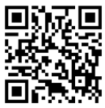
GPSS Annual Composition Survey
Please view the survey here:
https://forms.office.com/r/Jr3rh3D2TT

Slide 26
U-PASS
5 min
Notes:
richard

Slide 27
Student Technology Fee
5 min
Notes:
richard

Slide 28
Resolution For the Expansion of Class Accessibility
5 min
Notes:
richard

Slide 29
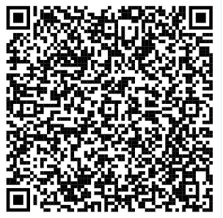
Resolution For the Expansion of Class Accessibility
You may review the Resolution using this link (Log in with UW account)
Resolution for the Expansion of Class Accessibility.docx

Slide 30
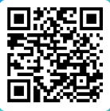
Resolution For the Expansion of Class Accessibility
Please vote using this form (log in with UW account)
https://forms.office.com/r/n2FmsA285x

Slide 31
Resolution to Improve Accessibility in the Dorms
10 min
Notes:
richard

Slide 32
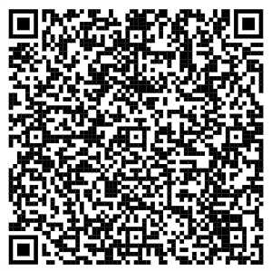
Resolution to Improve Accessibility in the Dorms
You may review the Resolution using this link (Log in with UW account)
GPSS Resolution to Improve Accessibility in the Dorms.docx

Slide 33
Resolution for Compliance with DEI and Non-discrimination Policies by the Jackson School of International Studies
25 min
Notes:
richard

Slide 34
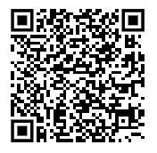
Resolution for Compliance with DEI and Non-discrimination Policies by the Jackson School of International Studies
You may review the Resolution using this link (Log in with UW account)
Resolution on Compliance with DEI and Non-Discrimination.docx

Slide 35
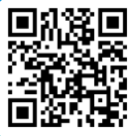
Resolution for Compliance with DEI and Non-discrimination Policies by the Jackson School of International Studies
Please vote using this form (log in with UW account)
https://forms.office.com/r/VFcLDQanac

Slide 36
Resolution in Support of Degree Completion Pathways for Students Affected by Visa Revocation
25 min
Notes:
richard

Slide 37
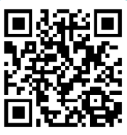
Motion to Suspend the Rules
25 min
Please vote using this form (log in with UW account)
https://forms.office.com/r/GHwQFLBmGA
Notes:
richard

Slide 38
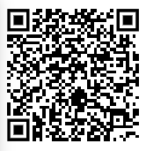
Resolution in Support of Degree Completion Pathways for Students Affected by Visa Revocation
You may review the Resolution using this link (Log in with UW account)
A Resolution in Support of Degree Completion Pathways for Students Affected by Visa Revocation.docx

Slide 39
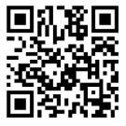
Resolution in Support of Degree Completion Pathways for Students Affected by Visa Revocation
Please vote using this form (log in with UW account)
https://forms.office.com/r/MTWZLYu3ZH

Slide 40
A Joint Resolution Between GPSS and ASUW to Address Allegations of Sexism Within the University of Washington’s Institutions
25 min
Notes:
richard

Slide 41
Equity Resource Guide and Toolkit
Sexual Assault Resources
UW Well Being
UW Live Well
Notes:
richard

Slide 42
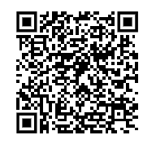
A Joint Resolution Between GPSS and ASUW to Address Allegations of Sexism Within the University of Washington’s Institutions
You may review the Resolution using this link (Log in with UW account)
A Joint Resolution to Address Allegations of Sexism and the Fostering of a Hostile Work Environment Affecting UW Students and Faculty.docx

Slide 43
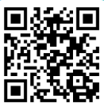
A Joint Resolution Between GPSS and ASUW to Address Allegations of Sexism Within the University of Washington’s Institutions
Please vote using this form (log in with UW account)
https://forms.office.com/r/UBEuVGzsLb

Slide 44
Resolution on Availability of Sharps Disposal Boxes on Campus
5 min
Notes:
richard

Slide 45
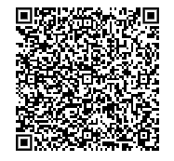
Resolution on Availability of Sharps Disposal Boxes on Campus
You may review the Resolution using this link (Log in with UW account)
Resolution on Sharps Disposal Boxes.docx

Slide 46
Resolution in Calling on University Administrators to Speak Out About Federal Funding Cuts and Overreach
5 min
Notes:
richard

Slide 47
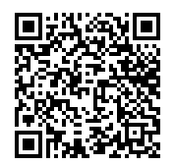
Resolution in Calling on University Administrators to Speak Out About Federal Funding Cuts and Overreach
You may review the Resolution using this link (Log in with UW account)
https://shorturl.at/x5JOz

Slide 48
GPSS FY 2026 Budget Projection
5 min
Notes:
richard

Slide 49
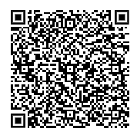
GPSS FY 2026 Budget Projection
You may review the proposal using this link (Log in with UW account)
FY26 Budget Projection (Senate Version).xlsx

Slide 50
Senator of the Month
5 min
Notes:
richard

Slide 51
Congratulations, Hector!
Thank you for your great work and dedication to GPSS!

Slide 52
Officer Updates
30 min
Notes:
richard

Slide 53
Adjournment
1 min
Notes:
richard

Slide 54
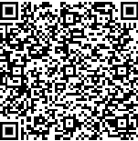
Follow us on Instagram :)
Join GPSS Senator Group on Teams

